Slide 1

Welcome to Year 3!

Slide 2
Teachers
Mr White(Class 7) and Miss Callaby(Class 8)
Supported by Mrs Palmer and Mrs Riley
Our Timings: 8.45am – 3.15pm

Slide 3
What will my child be learning?
In Autumn term, our topic is history based. We will be learning about different invaders and settlers, starting with the Stone age, moving onto the Romans and finishing with Anglo Saxons/Vikings before Christmas. Our science topics this term are focused on healthy lifestyles and rocks/soils which involves a fantastic trip to Meanwood Valley farm in November – more information to follow. We will have our first history visitor next week so look out for photos of what we do on the class pages of our website.
Home learning mats can be found in the home learning diary and are added to the class page on the school website each half term, linking to the new topic.

Slide 4
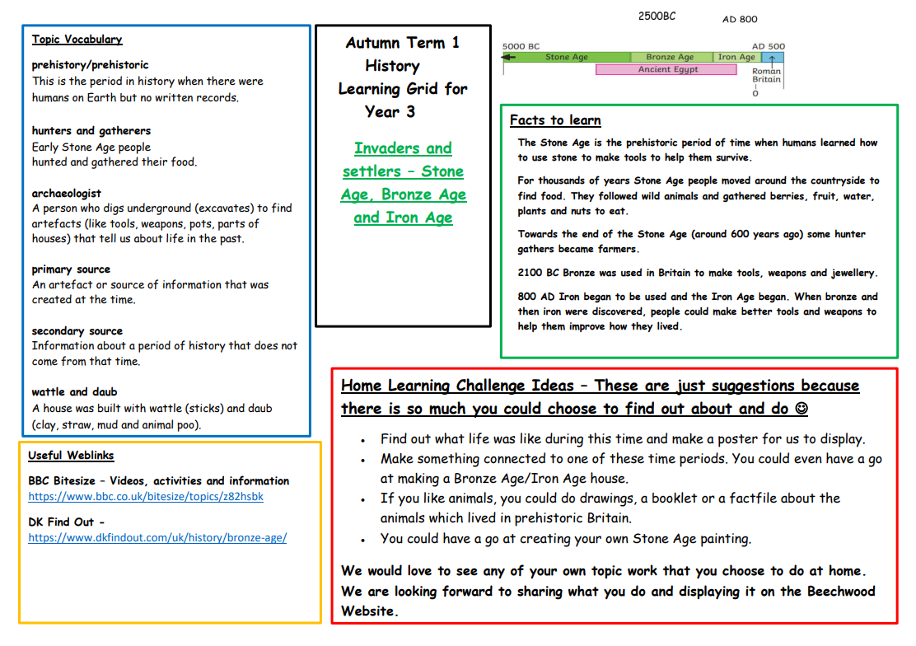
Year 3 home learning grid

Slide 5
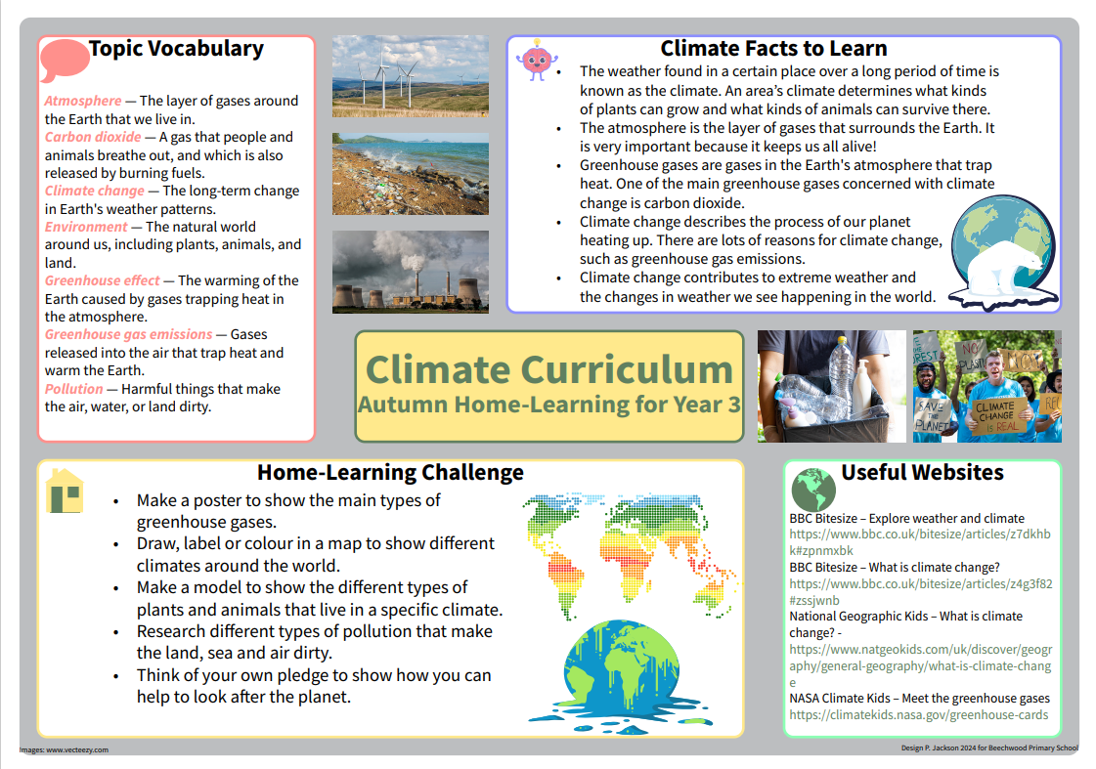
Year 3 Climate Learning Mat
In November, there will be a whole school climate joy day.
Year 3 will be taking part in a climate related programme called 'Agents of Change'.

Slide 6


We also have Golden Opportunities which they will tick off as the year progresses. These can also be found in the home learning diaries alongside our Beechwood Golden Opportunities which children will tick off by the end of their time at Beechwood.
Year 3 Golden Opportunities
Beechwood Golden Opportunities

Slide 7
How can I support my child at home?
Spellings are given out every Friday and children should practise these at home as well as at school. They should bring completed spellings back by the following Friday for our spelling test.
Maths homework will be set weekly on Fridays and is due back the following Friday.
Please record homework and home reading in the home learning diaries and make sure your child brings these to school each day.
Please continue to practise times tables with your child, both multiplication and division facts.
Here are some useful websites you could you to help your child at home.
Hit the Button and TTRS and www.timestables.co.uk
Ed Shed for spellings www.edshed.com
Purple Mash www.purplemash.com

Slide 8

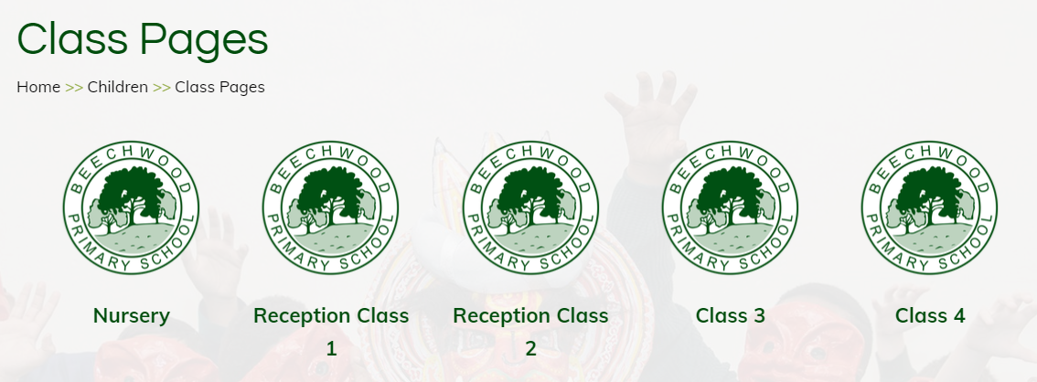
Where can I find out about events in school?
Important dates will be sent out via the school newsletter.
Class pages are updated regularly on the school website showing photos and updates of what your children have been learning about in school. We also have an Awards page to celebrate certificate winners each week.
Texts are sent home via my school app so please make sure you are signed up to this.

Slide 9
R.E. at Beechwood
At Beechwood, we follow the Believing and Belonging RE syllabus, which was updated last year. Our approach promotes inclusivity, respect and tolerance, ensuring all pupils gain a broad understanding of diverse beliefs and practices. Educational visits play a key role in bringing learning to life, offering real-world experiences that deepen pupils' understanding of different faiths. We also celebrate Interfaith Week with a rich programme of visitors, workshops and assemblies taking place during the year; fostering a respectful and open-minded school community.

Slide 10
What can my child bring to school?
Children are asked to bring a water bottle into school each day.
Children should bring their home learning diary and their reading book to school each day- please record any home learning and reading completed at home in these. Teachers will check these weekly.
Please make sure your child wears PE kit on Thursday and (Wednesday Class 7 - Monday Class 8).

Slide 11
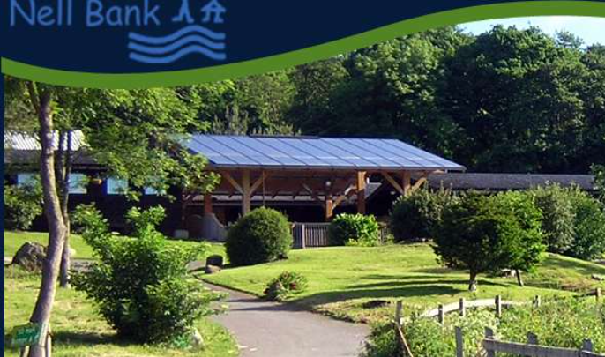
The Year 3 Nell Bank Residential
This is a fantastic one night residential on March 30th in Ilkley..
We stay at Nell Bank Centre and spend our time exploring the grounds and carrying out activities such as den building, pond dipping and orienteering. All activities are led by trained staff from the centre, aswell as Beechwood adults.
The children sleep in dormitories with their friends.
More information will follow about this trip soon. If you have any questions please see us at anytime. Our Beechwood office team will be able to give you more information about the payment plan for this trip.
www.nellbank.org .

Slide 12
Who can I speak to?
Your child’s teacher and teaching assistant will be available to speak to quickly on the playground in the morning and afternoon.
For any bigger queries or conversations, please speak to, phone, or email our office team and they can arrange a meeting or a phone call with your child’s class teacher.

Slide 13
Attendance
In order for your child to enjoy all that is on offer at Beechwood and to ensure that they make the excellent progress that we know they can, it is important that they are in school each day on time. We have many exciting attendance rewards.
Just a few from last year were:
Cinema vouchers Scooter
Slime Bikes
Bubble football

Slide 14
Thank you for coming and helping us to support your child in Year 3 ☺

