Slide 1

Welcome to Year 2!

Slide 2
What will my child be learning?
This term we will be learning about ‘South Africa’. We will be using maps to find out where it is and learn about the continents and oceans around the world. We will also be finding out about a very important person called Nelson Mandela and which animals live in the wild there. We have planned an exciting visit to the Yorkshire Wildlife Park on Wednesday 15th October which you will receive a Google form about. Our focus in Science will be all about ‘Taking Care’. Later on this year one of our topics will be ‘Explorers’ and we will explore The Solar System and famous explorers. In the final term, our topic is ‘The Seaside’ and we even get to visit Scarborough!
Home learning mats can be found in the home learning diary and are added to the class page on the school website each half term, linking to the new topic.
Each year group also have Golden Opportunities which they will tick off as the year progresses. These can also be found in the home learning diaries alongside our Beechwood Golden Opportunities which children will tick off by the end of their time at Beechwood.

Slide 3


Year 2 Golden Opportunities
Beechwood Golden Opportunities
G

Slide 4
How can I support my child at home?
Your child will receive spellings once a week on a Friday and we will test them the following Friday. Maths homework will be set most Fridays to bring in the following week.
Children are asked to read at least 3 times a week and this should be recorded in their home learning diaries.
Please return reading books with your home learning diary every Friday.
Children can access Reading Eggs, Purple Mash and Spelling Shed from home.

Slide 5
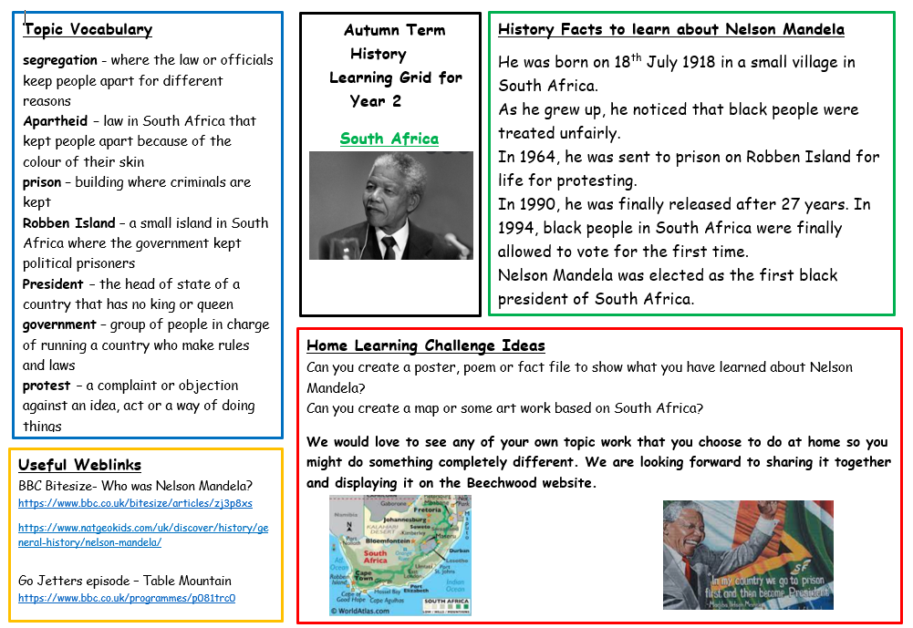
Year 2 home learning grid
G

Slide 6
Who can I speak to?
Your child’s teacher and teaching assistant will be available to speak to quickly on the playground in the morning and afternoon.
For any bigger queries or conversations, please speak to our office team and they can arrange a meeting or a phone call with your child’s class teacher.
A member of our SLT will be available each morning on the school grounds.
F

Slide 7

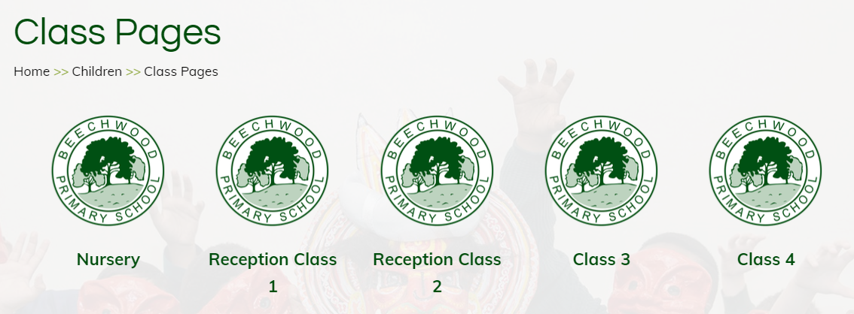
Where can I find out about events in school?
Important dates will be sent out via the school newsletter.
Class pages are updated regularly on the school website showing photos and updates of what your children have been learning about in school. We also have an Awards page to celebrate certificate winners each week.
Texts are sent home via my school app so please make sure you are signed up to this.
F

Slide 8
What happens before and after school?
All children will wait on the playground accompanied by an adult.
We ask that no ball games are played before or after school and children must stay on the KS1 playground and not climb on the walls, ensuring safety of pupils and adults.
Class teachers will come out to collect their class at 8:45am and children will line up.
At 3:15pm, classes will be brought out via the year 2 door and teachers will allow them to leave when they see a parent/carer.
What do I do if my child is being collected by someone else?
Please contact the office to inform us if someone other than a parent or carer is collecting your child that day.

Slide 9
What can my child bring to school?
Children are asked to bring a water bottle into school each day. We ask that these contain water (no sugary drinks are allowed).
Children should bring their home learning diary to school every Friday - please record any home learning and reading completed at home in these. Teachers or Teaching assistants will check these weekly.
Please ensure children have clothing appropriate for the weather e.g coat, sunhats

Slide 10
PE Days
Children can come to school in their PE kit on their class PE days:
Class 5 – Monday and Wednesday
Class 6 – Tuesday and Wednesday
F

Slide 11
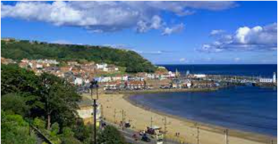


School visits
School visits have been carefully planned to complement our school curriculum.
In year 2 we visit -
More information will follow and you can pay this via parent pay.
Please see the office team if you need any support with this.
We also have visitors and workshops in school.E.
respectful and open-minded school community.

Slide 12
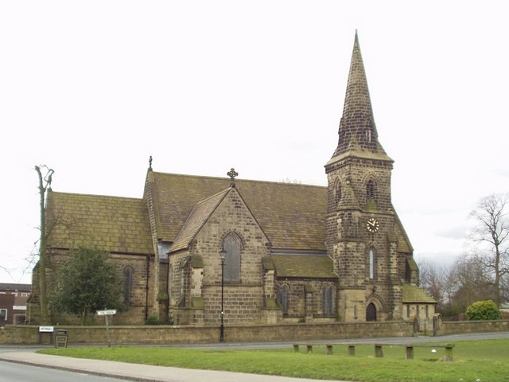
School visits
R.E.
respectful and open-minded school community.
At Beechwood, we follow the Believing and Belonging RE syllabus, which was updated last year. Our approach promotes inclusivity, respect and tolerance, ensuring all pupils gain a broad understanding of diverse beliefs and practices. Educational visits play a key role in bringing learning to life, offering real-world experiences that deepen pupils' understanding of different faiths. We also celebrate Interfaith Week with a rich programme of visitors, workshops and assemblies taking place during the year; fostering a respectful and open-minded school community.

Slide 13
Other opportunities
School Council
Eco club
After school clubs
Place to talk
Sports Coaches (LUFC, GT Sports, Premier Sports)
Singing and drumming sessions
G

Slide 14
Attendance
In order for your child to enjoy all that is on offer at Beechwood and to ensure that they make the excellent progress that we know they can, it is important that they are in school each day on time. We have many exciting attendance rewards.
Just a few from last year were:
* bikes
* scooters
* Easter eggs
F

Slide 15
Feel free to ask any questions.
Thank you for coming and helping us to support your child with their journey in Year 2 ☺
G

