Slide 1










Beechwood’s Biodiversity Week
Biodiversity Quiz

Slide 2



Question One:
What does biodiversity mean? a) Different types of rocks b) The variety of life on Earth c) All of the stars

Slide 3

Question Two:
Which of these is an example of biodiversity? a) A garden with only one type of flower b) A rainforest with many different plants and animals c) a fish in a tank

Slide 4

Question Three:
There are different types of forests which are very biodiverse places! Where in the world are most rainforests found? a) In the northern hemisphere b) Antarctica c) Near the equator

Slide 5
Question Four:
Which of these species doesn’t have a home in the forest? a) Orangutan b) Great hornbill c) Cheetah?

Slide 6
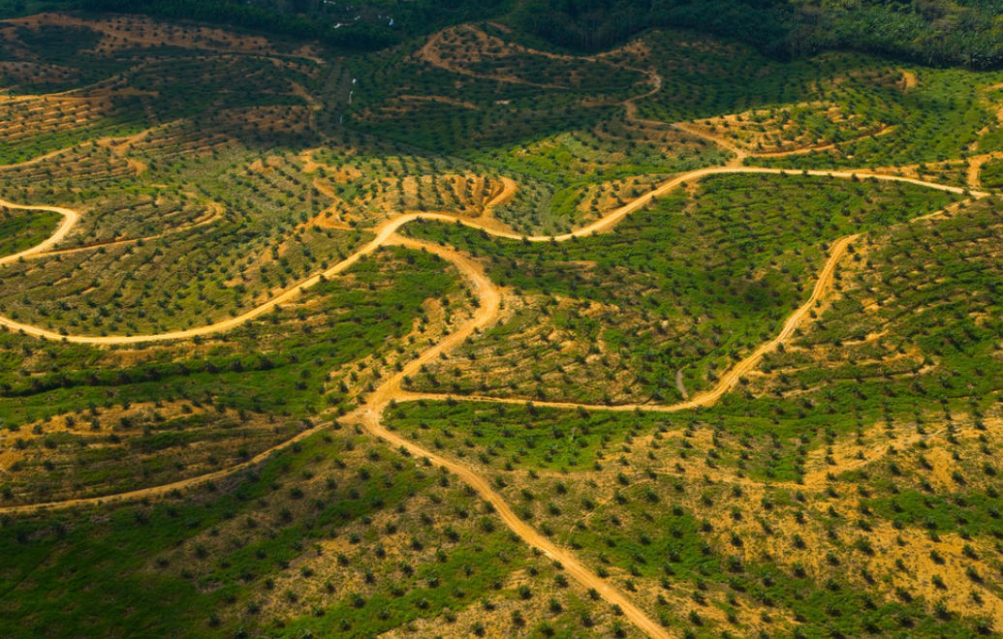
Question Five:
Across Sumatra and Borneo, forests are being cleared to plant this crop which is bad for biodiversity. What is it? a) Oil Palms b) Rubber Trees c) Bamboo

Slide 7
Question Six:
Why is it important to protect biodiversity? a) Because it makes the world more colourful b) Because it helps keep ecosystems healthy c) Because it makes animals happy

Slide 8
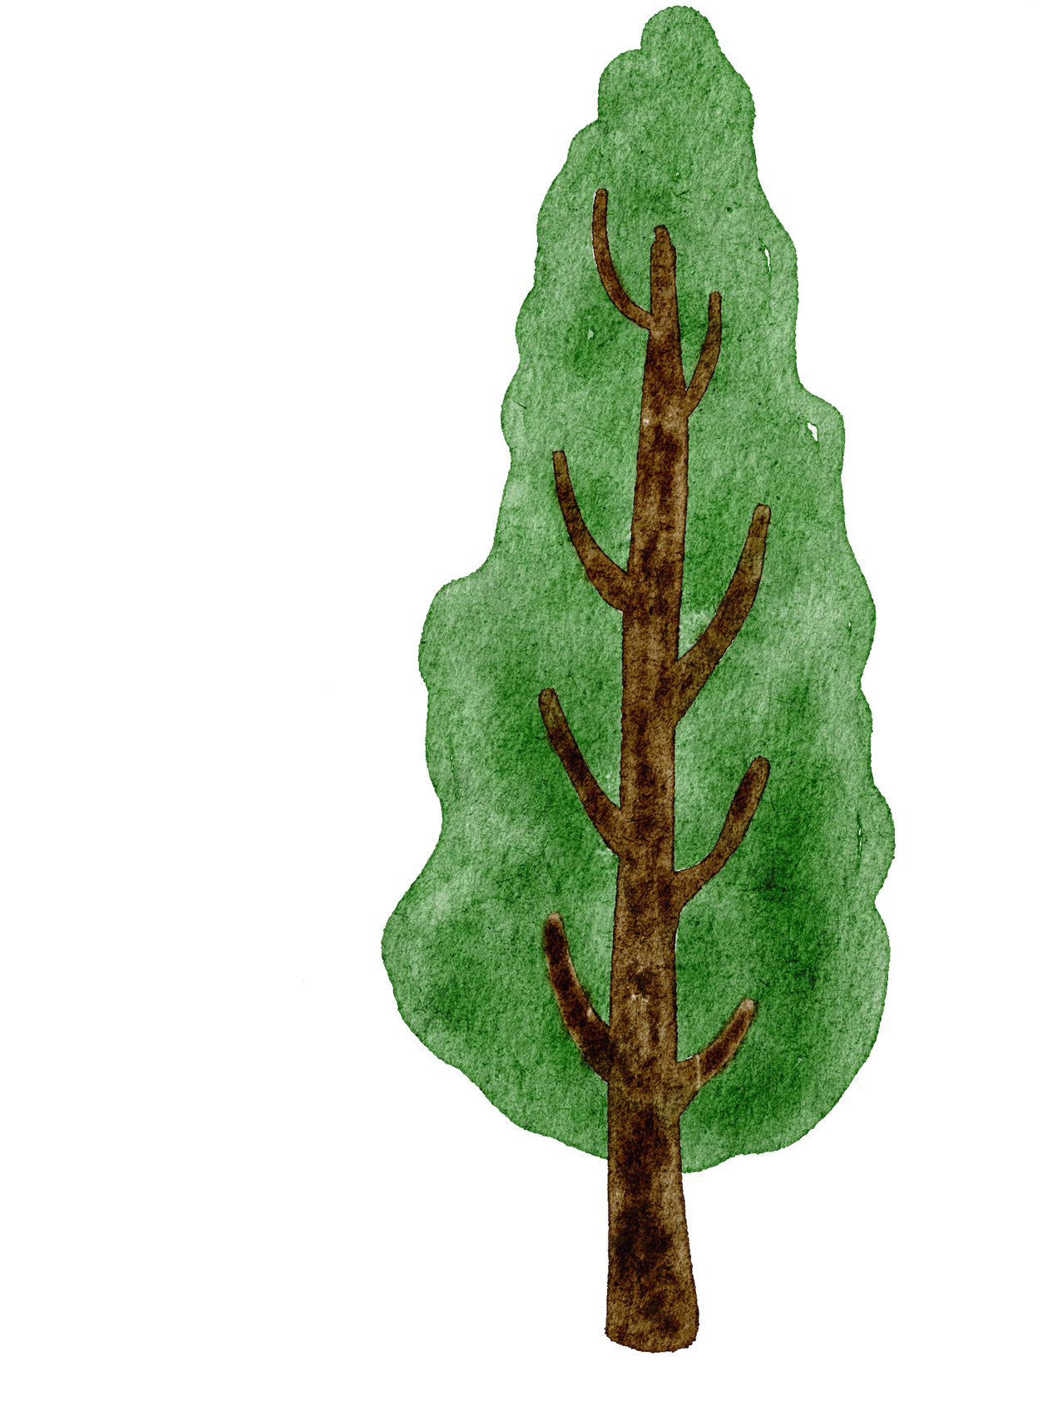
Question Seven:
What is an ecosystem? a) A group of people b) A community of living and things c) A type of animal

Slide 9


Question Eight:
Which of the following is NOT a part of an ecosystem? a) Plants b) Bacteria c) Stone

Slide 10


Question Nine:
What is an endangered species? a) A species that lives only in zoos b) A species that is in danger of disappearing forever c) A species that is very common

Slide 11


Question Ten:
Why are some animals endangered? a) Because their habitats are being destroyed b) Because they are too big c) Because they are too fast

Slide 12


Question Eleven:
Name one thing people can do to help protect biodiversity. a) Use less plastic b) Watch more TV c) Drive more cars

Slide 13

Question Twelve:
What is adaptation? a) Changing the colour of your clothes b) Changing your behaviour to survive in a new environment c) Changing your friends

Slide 14

Question Thirteen:
Which of the following is a way in which climate change impacts biodiversity? a) It has no impact on biodiversity b) It causes some species to move to new areas c) It only affects plants

Slide 15


Question Fourteen:
Which of the following is not a major cause of deforestation? a) Mining b) Logging c) Education

Slide 16

Question Fifteen:
Biodiversity includes which of the following in an ecosystem? a) All non-living things b) All living things c) Only plants and animals

Slide 17


Question Sixteen:
Which statement is true of extinction? a) It is occurring all the time b) It occurs less frequently over time c) It only happens during mass extinction events

Slide 18

Question Seventeen:
Which statement is true of new species? a) They are evolving all over the world b) They are unlikely to go extinct c) They are threats to biodiversity

Slide 19

Question Eighteen:
Which species are most vulnerable to extinction? a) Those with small populations b) Those with big habitats c) Those with short life cycles

