Slide 1

Welcome to Year 1!

Slide 2
What will my child be learning?
This term we will be exploring ‘Who Am I?’ We will be thinking about changes over time in how the children have developed since birth, as well as similarities/differences between the experiences of parents and grandparents. Our focus in Science will be all about ‘Using our Senses’. We have planned an exciting visit to Eureka for later in the term. Later on this year one of our topics will be Food from Many Nations and we will explore the history of food and food around the world. In the final term our topic is Houses and Homes around the World and we even visit a castle!
Home learning mats can be found in the home learning diary and are added to the class page on the school website each half term, linking to the new topic.
Each year group also have Golden Opportunities which they will tick off as the year progresses. These can also be found in the home learning diaries alongside our Beechwood Golden Opportunities which children will tick off by the end of their time at Beechwood.

Slide 3

Year 1 Golden Opportunities
Beechwood Golden Opportunities

Slide 4
How can I support my child at home?
Your child will receive spellings once a week when we feel they are ready. This will be different for different groups of children.
Children are asked to read at least 3 times a week and this should be recorded in their home learning diaries.
Please bring in the home learning diary every day.

Slide 5
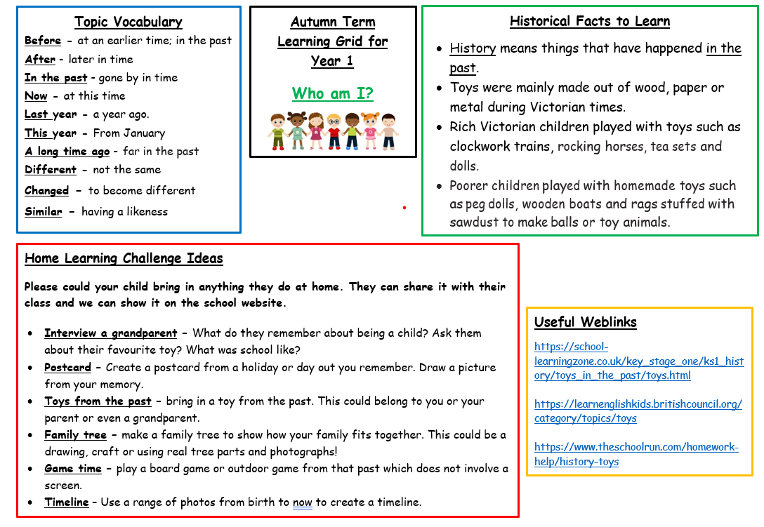
Year 1 home learning grid

Slide 6
Who can I speak to?
Your child’s teacher and teaching assistant will be available to speak to quickly on the playground in the morning and afternoon.
For any bigger queries or conversations, please speak to our office team and they can arrange a meeting or a phone call with your child’s class teacher.
A member of our SLT will be available each morning on the school grounds.

Slide 7

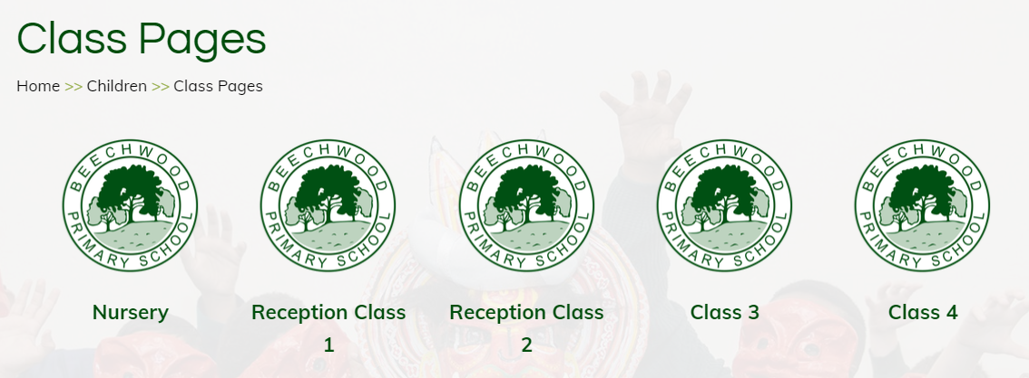
Where can I find out about events in school?
Important dates will be sent out via the school newsletter.
Class pages are updated regularly on the school website showing photos and updates of what your children have been learning about in school. We also have an Awards page to celebrate certificate winners each week.
Texts are sent home via my school app so please make sure you are signed up to this.

Slide 8
What happens before and after school?
All children will wait on the playground accompanied by an adult.
We ask that no ball games are played before or after school and bikes and scooters must not be ridden in the playground, ensuring safety of pupils and adults.
Class teachers will come out to collect their class at 8:45am and children will line up.
At home time, classes will be brought out to meet their parents/carers into the Key Stage 1 playground at 3:15. Please do not call your child out of the class line. We will hand them over to you. We appreciate your patience as we want to ensure safety.

Slide 9
What do I do if my child is being collected by someone else?
Please contact the office to inform us if someone other than a parent or carer is collecting your child that day.

Slide 10
What can my child bring to school?
Children are asked to bring a water bottle into school each day. We ask that these contain water (no flavoured drinks are allowed). Water bottles should be labelled.
Children should bring their home learning diary to school each day- please record any home learning and reading completed at home in these. Teachers will check these weekly.

Slide 11
PE
Class 3: Monday and Thursday
Class 4: Monday and Friday
Children must come to school in their PE kit (shorts or jogging bottoms, t shirt, trainers and school jumper or hooded top as we sometimes do PE outside.)
Children must wear no jewellery, including earrings. Studs can be worn but will need to be covered with medical tape for the lesson.

Slide 12
School visits!
School visits have been carefully planned to complement our school curriculum.
In year 1 we visit-
Eureka, The Chocolate Story (York), Skipton Castle.
More information will follow and you can pay this via parent pay. Please see the office team if you need any support with this.
We also have visits and workshops.

Slide 13
Other opportunities
School Council
After school clubs
Sports Coaches (LUFC, GT Sports, Premier Sports)

Slide 14
Attendance
In order for your child to enjoy all that is on offer at Beechwood and to ensure that they make the excellent progress that we know they can, it is important that they are in school each day on time. We have many exciting attendance rewards.

Slide 15
Feel free to ask any questions. Thank you for coming and helping us to support your child with their journey in Year 1 ☺

