Slide 1


Year 1
Phonics Screening Check
Parents information meeting
Monday 12th January 2026
Notes:
Welcome to our meeting where we will give you some information about the Phonics Screening check which is a mandatory government assessment.

Slide 2
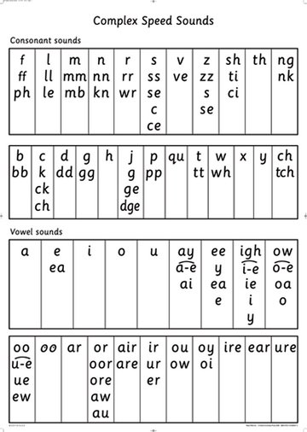
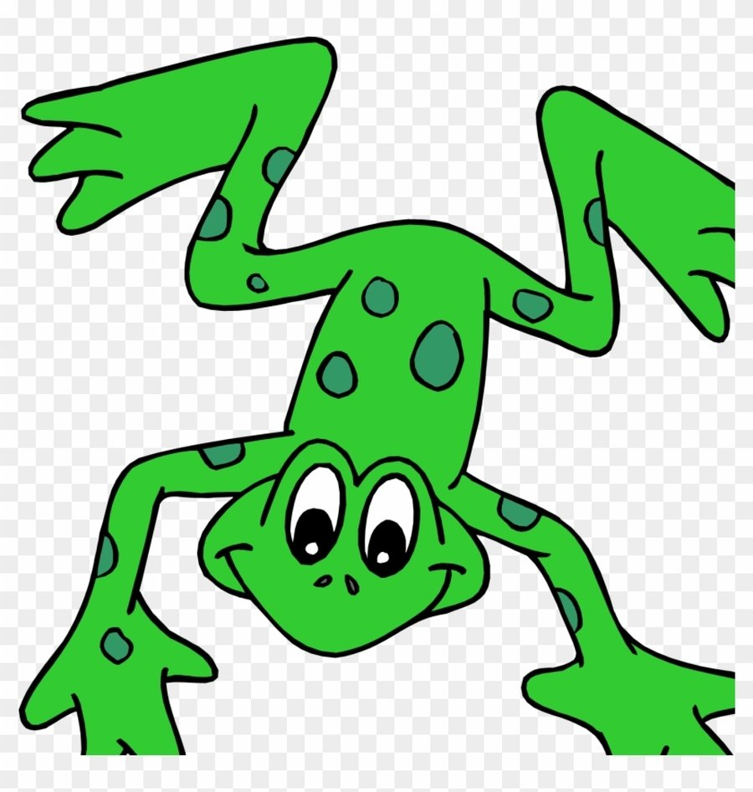
What is Phonics?
The way we teach children to read!
We use the Read Write Inc programme to teach children phonemes (letter sounds).
They use these sounds to segment words and then blend them back together.
Fred Talk
Special friends
Notes:
By the end of Year 1, we want all of our children to be able to read accurately – to read both familiar and unfamiliar words - so that they can go on to become a fluent, enthusiastic reader. Accurate word reading at 6 is a predictor of future success.
Children learn all of the sounds on this chart.
Once they know all of these sounds, they will be able to read any unfamiliar word.

Slide 3
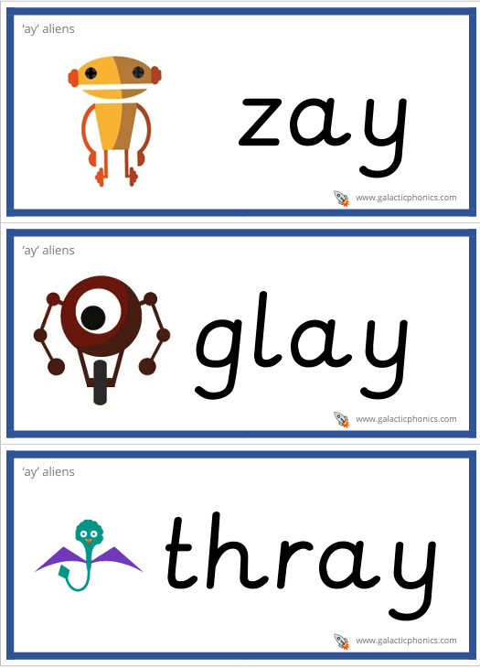
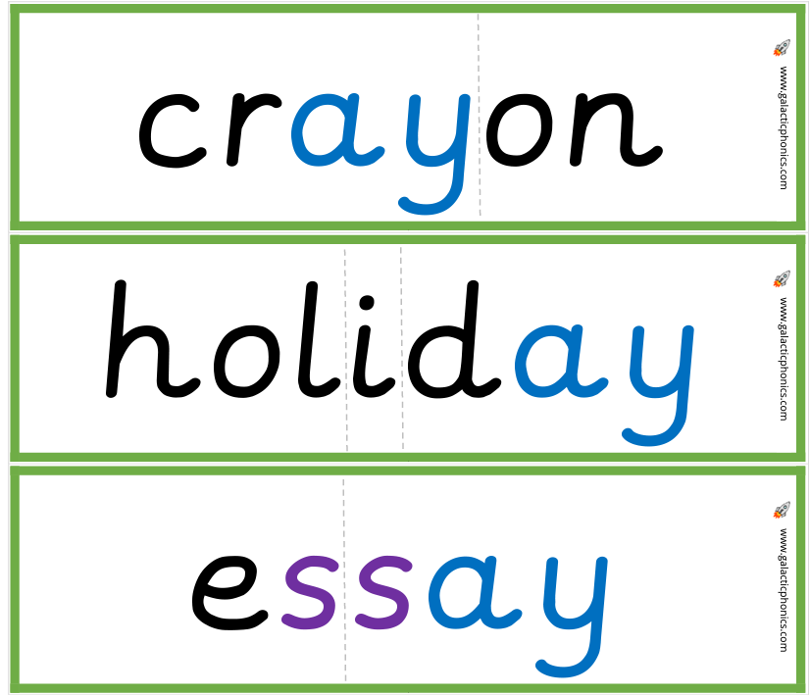
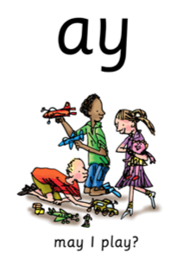
Phonics in action…
ay
Notes:
You may hear the children say ‘special friends’. That is 2 letters that make one sound, a digraph.
The children also read ‘alien’ words which are pseudo or nonsense words containing the digraphs they have learned.

Slide 4
What is the Phonics Screening Check?
The Phonics Screening Check is designed to confirm whether individual children have learnt sufficient phonic decoding and blending skills to an age appropriate standard.
This year the check will take place week beginning Monday 8th June. All children in Year 1 will be checked during this week unless you have been informed otherwise.
Notes:
The Phonics Screening Check in June in year 1 is a word reading test to check children can read sounds in words accurately.
If children are absent that week they can be tested the following week up until the Friday deadline. If they were still absent they would then be recorded as absent on the system.

Slide 5
What happens during the check?
The check contains 40 words.
Each child will sit 1:1 and read each word aloud to the teacher.
The check will take approximately 4-10 minutes per child although all children are different and will complete the check at their own pace.
The list of words the children read is a combination of 20 real words and 20 pseudo words (nonsense words).

Slide 6
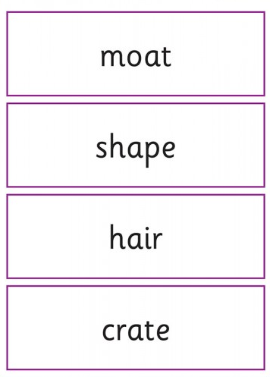
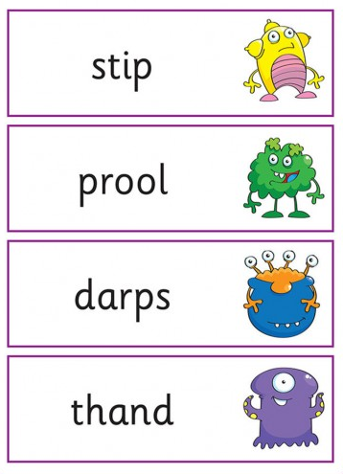
Examples of the check:

Slide 7
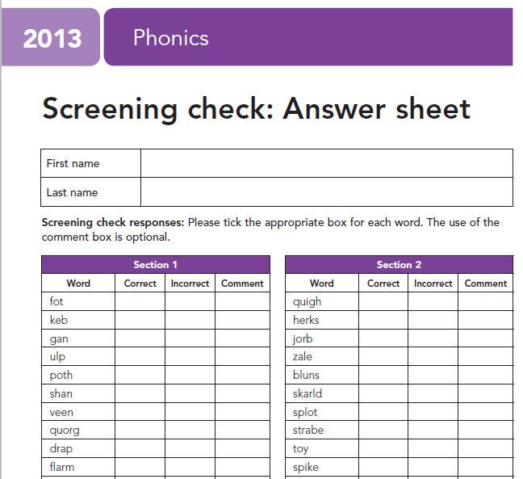
Examples of the check:
We put a tick in the correct column if the child reads the word accurately.
We also tick the incorrect column if the child does not get the word correct because we do not want them to feel anxious if they see a cross or a dot which could then impact negatively on the rest of the phonics check.

Slide 8
Reporting the results
The pass mark could be anywhere between 32-36 words read correctly. The threshold mark is not communicated to schools until after the test is completed.
School will report the results to the local authority. The DFE use this data to determine which pupils have not met the expected standard in phonics. Parents will find out whether their child passed on their school report.
Those children not meeting the standard in Year 1 will re-do the check in Year 2.

Slide 9
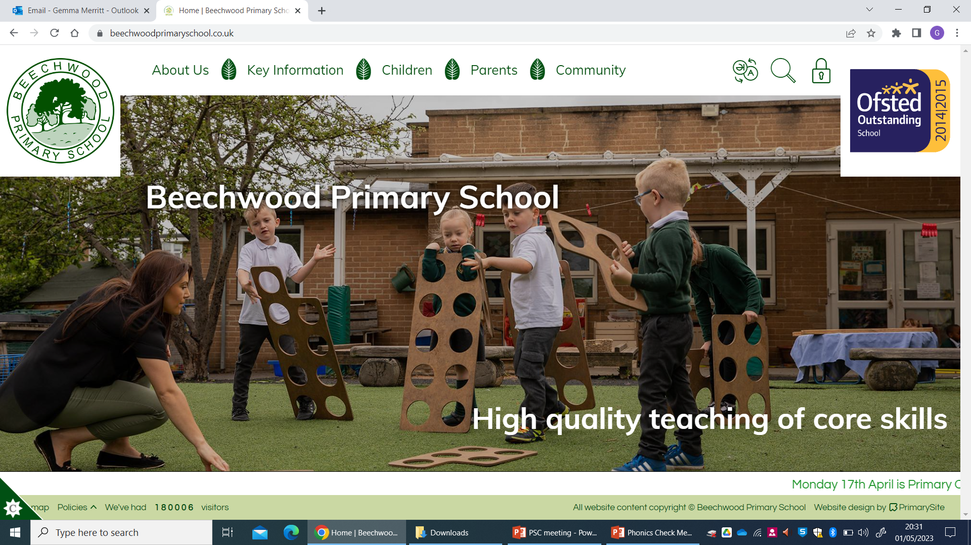
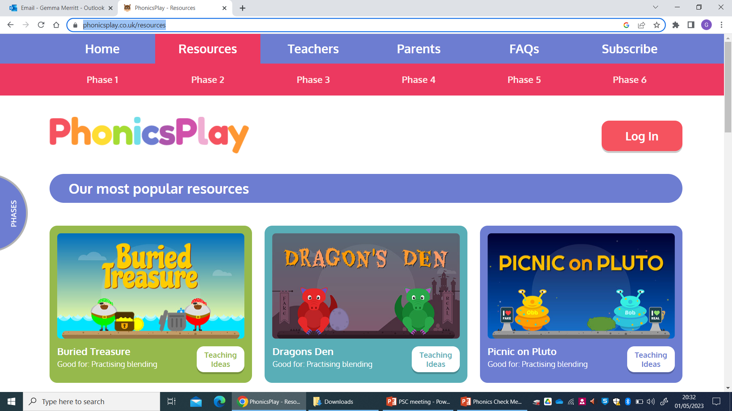
How can I help my child at home?
Complete any phonics homework sent by your child’s phonics teacher. Follow the virtual classroom links sent in the phonics newsletters.
Visit our school website to find phonics support videos:
Use www.phonicsplay.com to practise reading
real and nonsense words
Listen to your child read 3x a week.

Slide 10
Thanks for coming!
If you have any questions following this meeting then please speak to your child’s class teacher.

