Slide 1


Early reading workshop
Parents information meeting
Wednesday 2nd October 2024

Slide 2
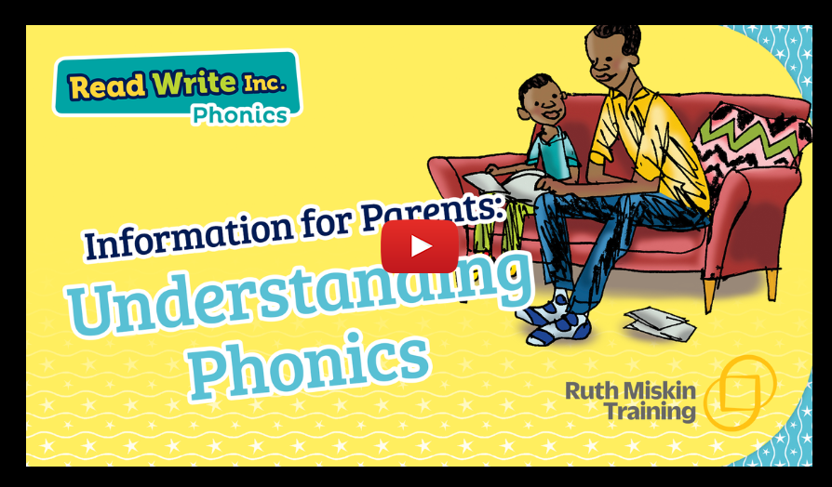
What is Phonics?

Slide 3
What is Phonics?
The way we teach children to read!
Phonics - the sounds that our alphabet represent. We have 26 letters, 44 sounds and 150+ ways of writing those sounds!! It is the most difficult language to crack!
We use the Read Write Inc programme to teach children phonemes (letter sounds).
We need to make sure our children learn these sounds quickly and that they are embedded. The best way to do that is have fun learning, but also repeat, practise and repeat again and again and again!

Slide 4
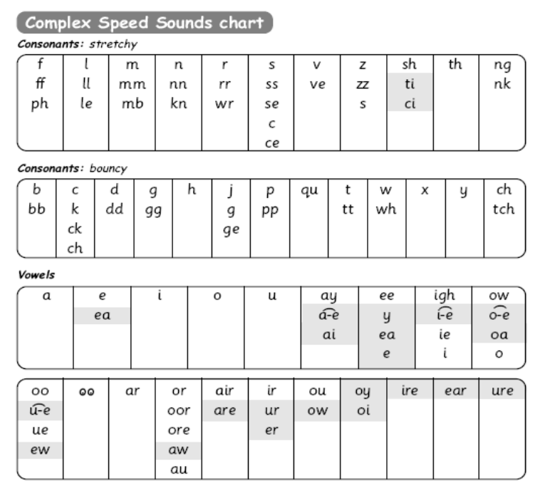
How do we teach the sounds?
Speed Sounds
The sounds are split up into 3 sets.
There are BOUNCY sounds…
…and STRETCHY sounds!

Slide 5
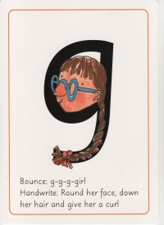
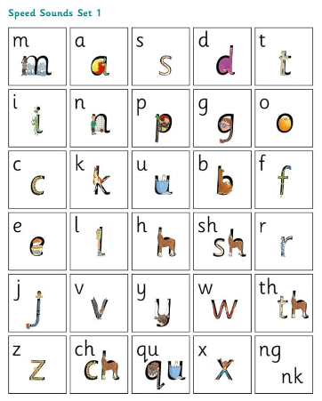

Set 1 sounds
g

Slide 6

My
turn!

Slide 7

Your turn ☺

Slide 8



TTYP
Turn to your partner!

Slide 9

Pure sounds
It is vital that we teach our children to pronounce the sounds correctly.
We call these Pure Sounds.

Slide 10

Blending sounds
Once the children have learnt some sounds they can start to blend them to begin to read words.
Fred the Frog helps us to learn our sounds!
He only speaks in sounds.
He helps the children listen to the sounds and begin to blend the words without reading them.
Let’s see if you can do it!

Slide 11

Word time
c–a-t cat
l–u-n-ch lunch

Slide 12

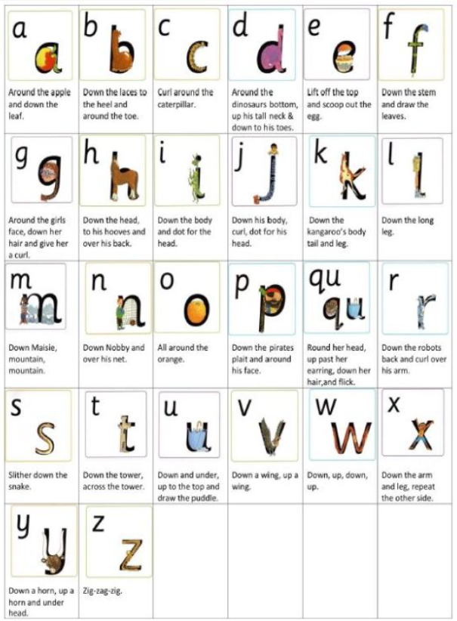
Writing
Each of the sounds in Set 1 has a rhyme which supports the children in forming the letter correctly when writing.
We have developed our own videos to support this process.
Children practise these on whiteboards and other supportive activities.

Slide 13
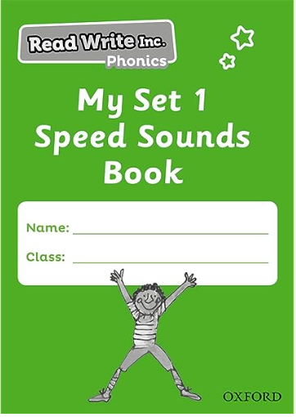

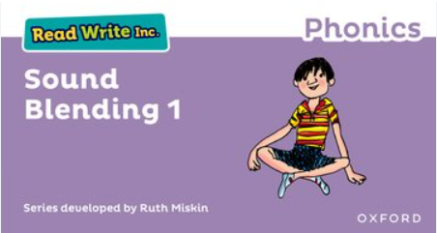

Home reading
Reading books are sent home on a Friday to match your child’s reading level.
Reading books are kept for a week and changed again on a Friday.
Please take care of these books.
Please write a comment in your child’s home-school diary when you read at home together.
We ask children to read at home 3 times a week. Each half term teachers will choose a reading champion who will win a book prize!

Slide 14
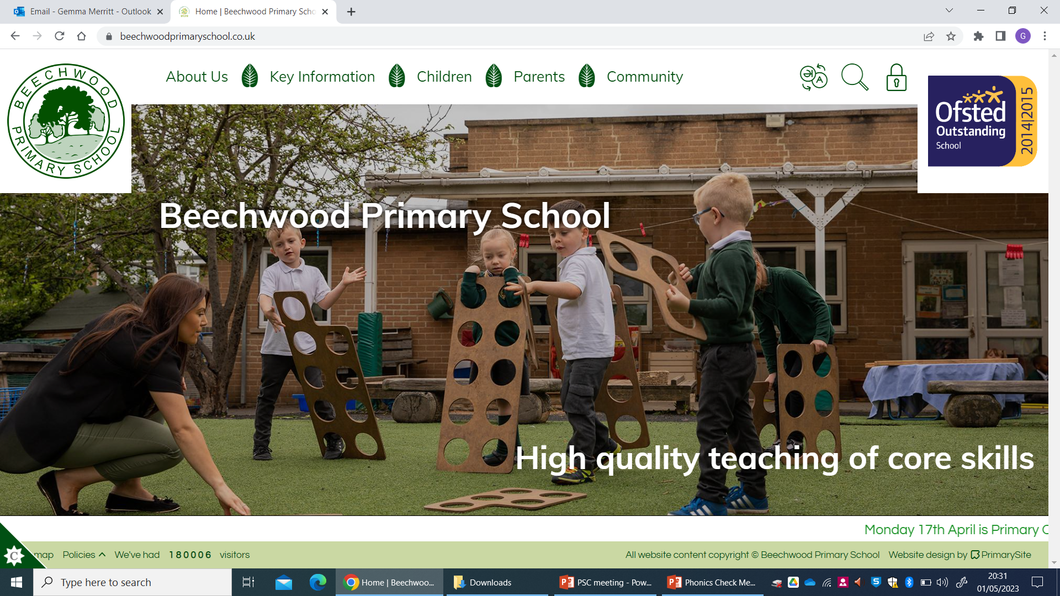

How can I help my child at home?
Look out for the links to handwriting videos and speed sound lessons to recap learning at home.
Visit our school website to find phonics support videos:
Listen to your child read 3x a week.
Use to practise too!

Slide 15
Thanks for coming!
If you have any questions, please speak to your child’s class teacher, Miss Westfield or Mrs Merritt.

