Slide 1

ParentPay. A Guide for Parents/Carers
Beechwood Primary School will be going Cashless from September 2020 and will no longer accept any cash Payments.
The Following information will help Parents/Carers become familiar with the system, and we will shortly be issuing activation letters to each Year Group.

Slide 2
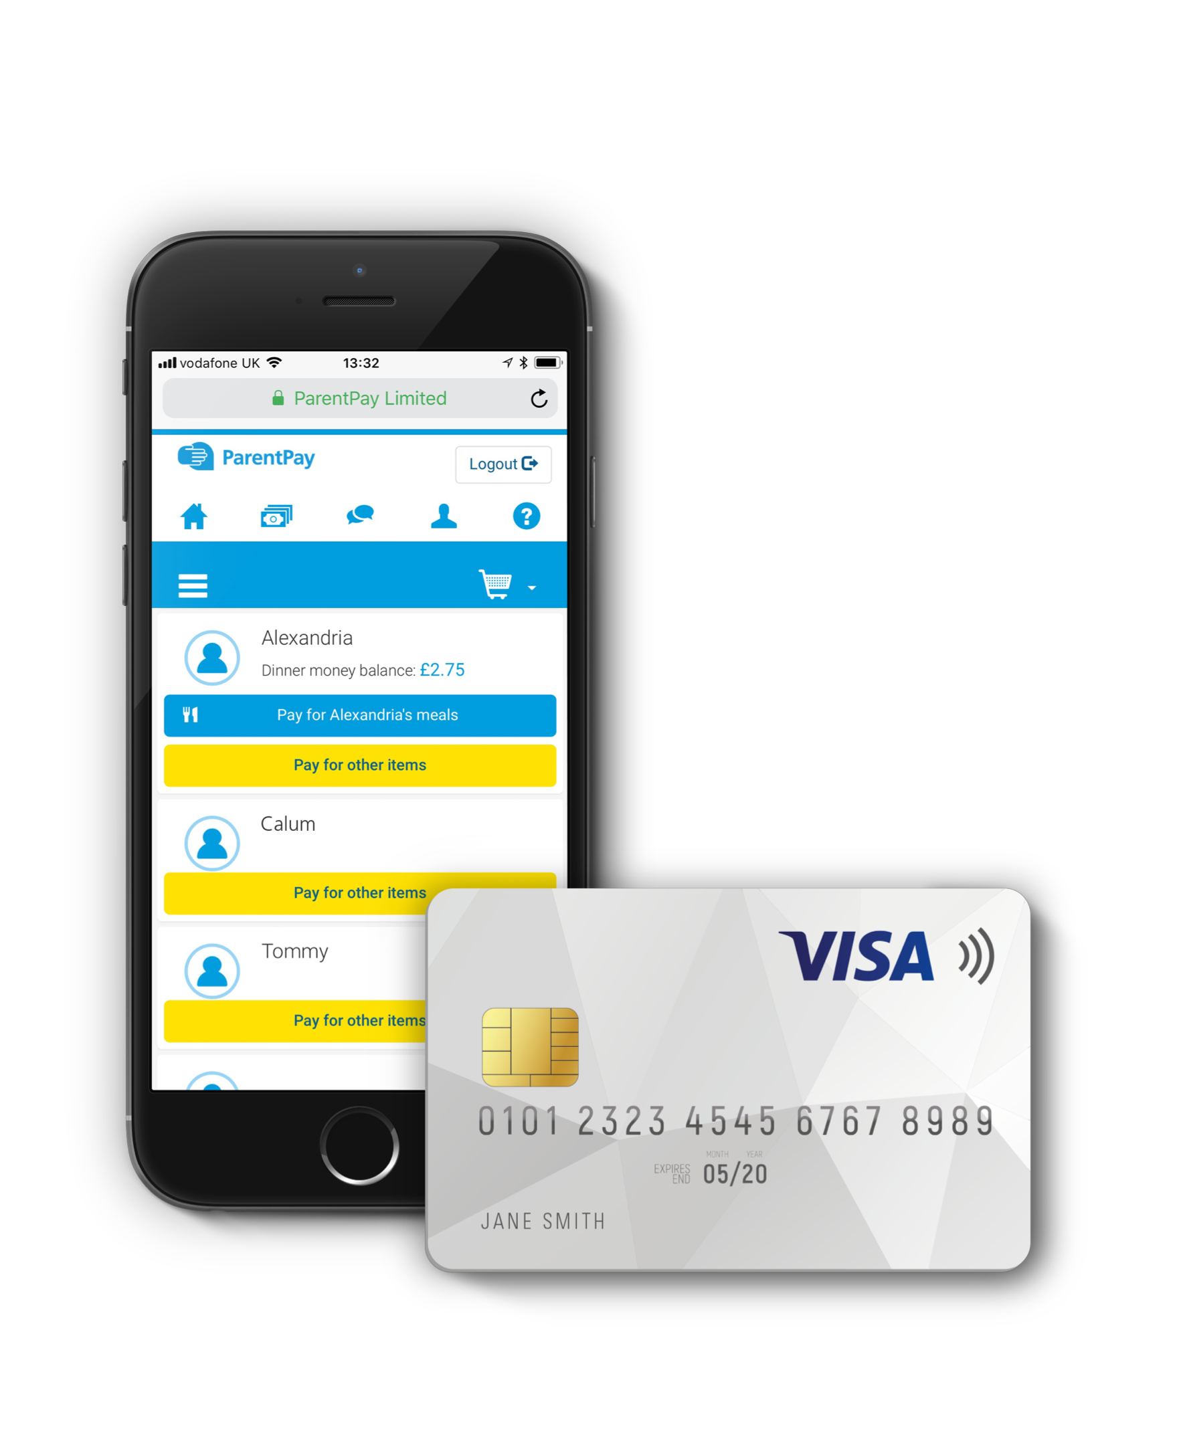









PAY ONLINE FOR SCHOOL DINNERS, TRIPS AND CLUBS
IT’S EASY, QUICK AND SAFE
© ParentPay 2019
parentpay.com

Slide 3



WHY USE PARENTPAY…
Convenient & transparent
Paying online makes life easier for everyone!
Saves our school time to focus on teaching
Trusted
ParentPay’s been used by schools for over 15 years…
Used by over 4 million parents across the UK
Safe & Secure
Removing cash from school helps keep pupils safe
Your money is guaranteed to be spent on what it was intended for!
Helps us to help your children
Going cashless helps us focus on what’s important – your children

Slide 4

WHAT HAPPENS NEXT…IT’S EASY
Step 1 – You’ll get a letter from us about ParentPay.
Includes information about how to activate your account
Step 2 – Activate your account.
Use the codes in your letter and you will be able to pay for school dinners and other items straight away
Step 3 – Don’t miss out!
Don’t forget to set up Alerts so you receive an email (free) or SMS text when your balance is low or there are new items to pay for

Slide 5



Really helpful for school related payments
ParentPay made my life as a busy mum so much easier. Now I can pay for school trips and lunch in my own time and I do not have to worry about cash.
Olga Cara, UK
Brian Parsons, UK
ParentPay is great!
So easy to pay for school related items, particularly lunches.
You can see what choices your child is making and keep an eye on the balance easily.

