Slide 1
Our visit to London
By Bella and Isla

Slide 2
Day one
On day one we went straight to the Imperial war museum.We had a long and fun day.We went on the london eye although it was a bit scary but fun at the same time.Our favrouite part of day one was the london eye and pizza express.

Slide 3
Day two
On day two we went straight to the science museum “it was really fun!”After that we went inside the wonder lab.The wonder lab was very cool because we got to do lots of experiments!We got to touch alot of stuff and we got to go on the slides!We watched the lion king eventhough nearly everyone fell asleep but it was worth it to watch.Our favrouite part was of day tow is the lion king.

Slide 4
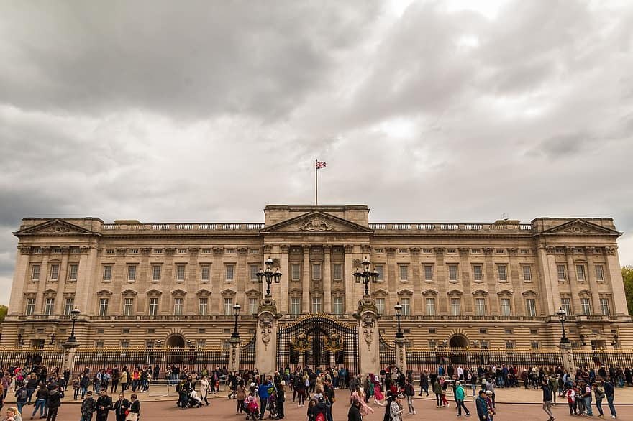
Day three
On our last day of london we went to the natural history museum, Art gallery and on the way home Buckingham palace. All of london was great we all had a good time. We all were tired on the way home but we would say it was worth it.

