Slide 1
London Landmarks
By Cole and Jace

Slide 2
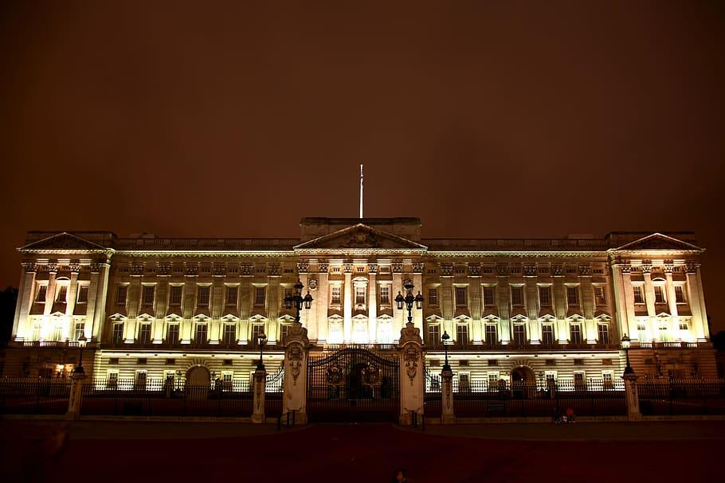
Buckingham Palace
The original Buckingham House was transformed by the esteemed architect John Nash into what it is today. However, he accidentally went over budget. He was eventually fired from the project. But without his mistake,we would have the palace we all know and love today. So really, Nash should be pardoned. If that’s a thing that can be done. Buckingham palace has hosted thousands of visitors throughout the years and with a whopping 775 rooms, it’s not hard to see how. That included 52 royal and guest bedrooms, 188 staff bedrooms, 19 staterooms and 78 bathrooms. All told, it’s safe to say that there’s more than enough royal family. Even if there are many more royal children to come. At least we might get some more national holidays if they do. That is how it works, right?

Slide 3
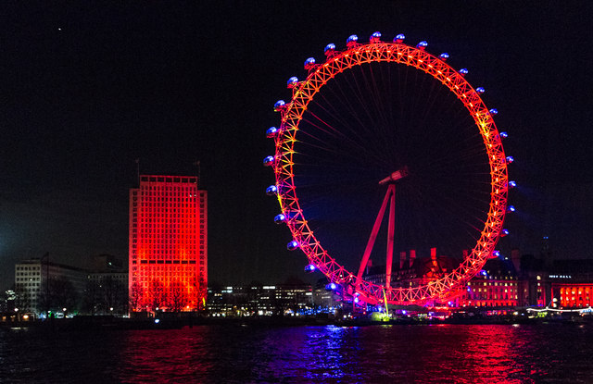
London Eye
ltAhough the London Eye is often called a ferris wheel, experts disagree. Instead, it is a “ cantilevered observation wheel” - with a mouth full of a name like that, it is no wonder so many go with “ferris” instead! So what is the big difference? Well, the London Eye is supported by an a-frame only one side, and the climate-controlled capsules do not hang down like a traditional ferris wheel. Whether it is a ferris or cantilevered observation wheel, it is europe’s largest wheel. Specifically, if you are wondering how big the London Eye is- it is a pretty dizzying 135 metres. That is an interesting London eye fact, however it used to be even more impressive.

Slide 4
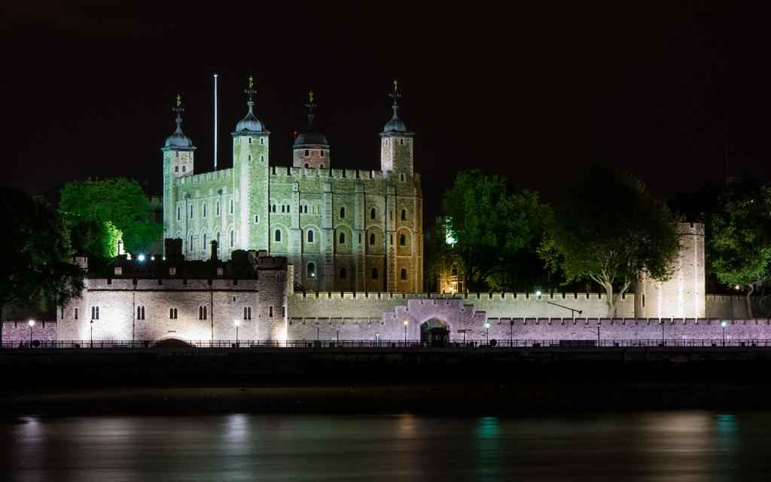
Tower of London
They lodge on the south lawn and their fun personalities can be seen when you visit the Tower-they love to mimic sounds and play games amongst each other. The current ravens have been given adorable names:jubilee, harris, gripp, rocky, erin, poppy and georgie. That is all very well, but what happens if the ravens fly away, we hear you ask? It is a little bit ominous - Charles II is widely believed to have been the first Royal to insist that the ravens must stay put. If the Tower is ever abandoned by its resident ravens, it’s said that the Kingdom and the Tower of London will fall.Not ideal - let’s pray they stay there, then.

Slide 5
Nelson’s Column
Nelson’s Column is one of England’s most iconic sites. It is located in London’s Trafalgar Square. It was built to commemorate Admiral Horatio Nelson. He was a British officer who served in the Royal Navy and died at the Battle of Trafalgar in 1805. The construction of this national monument was mostly funded by private donations. In today’s money, its value is more than £3 million. The structured was designed by William Railton as he won a protracted competition. In 1867, the four bronze lions were added to Nelson’s Column which are sitting at the base. These lion sculptures were designed by Sir Edwin Landseer who used a dead lion as the model. The lions were made out of metal from guns that had been taken from old battleships.

Slide 6
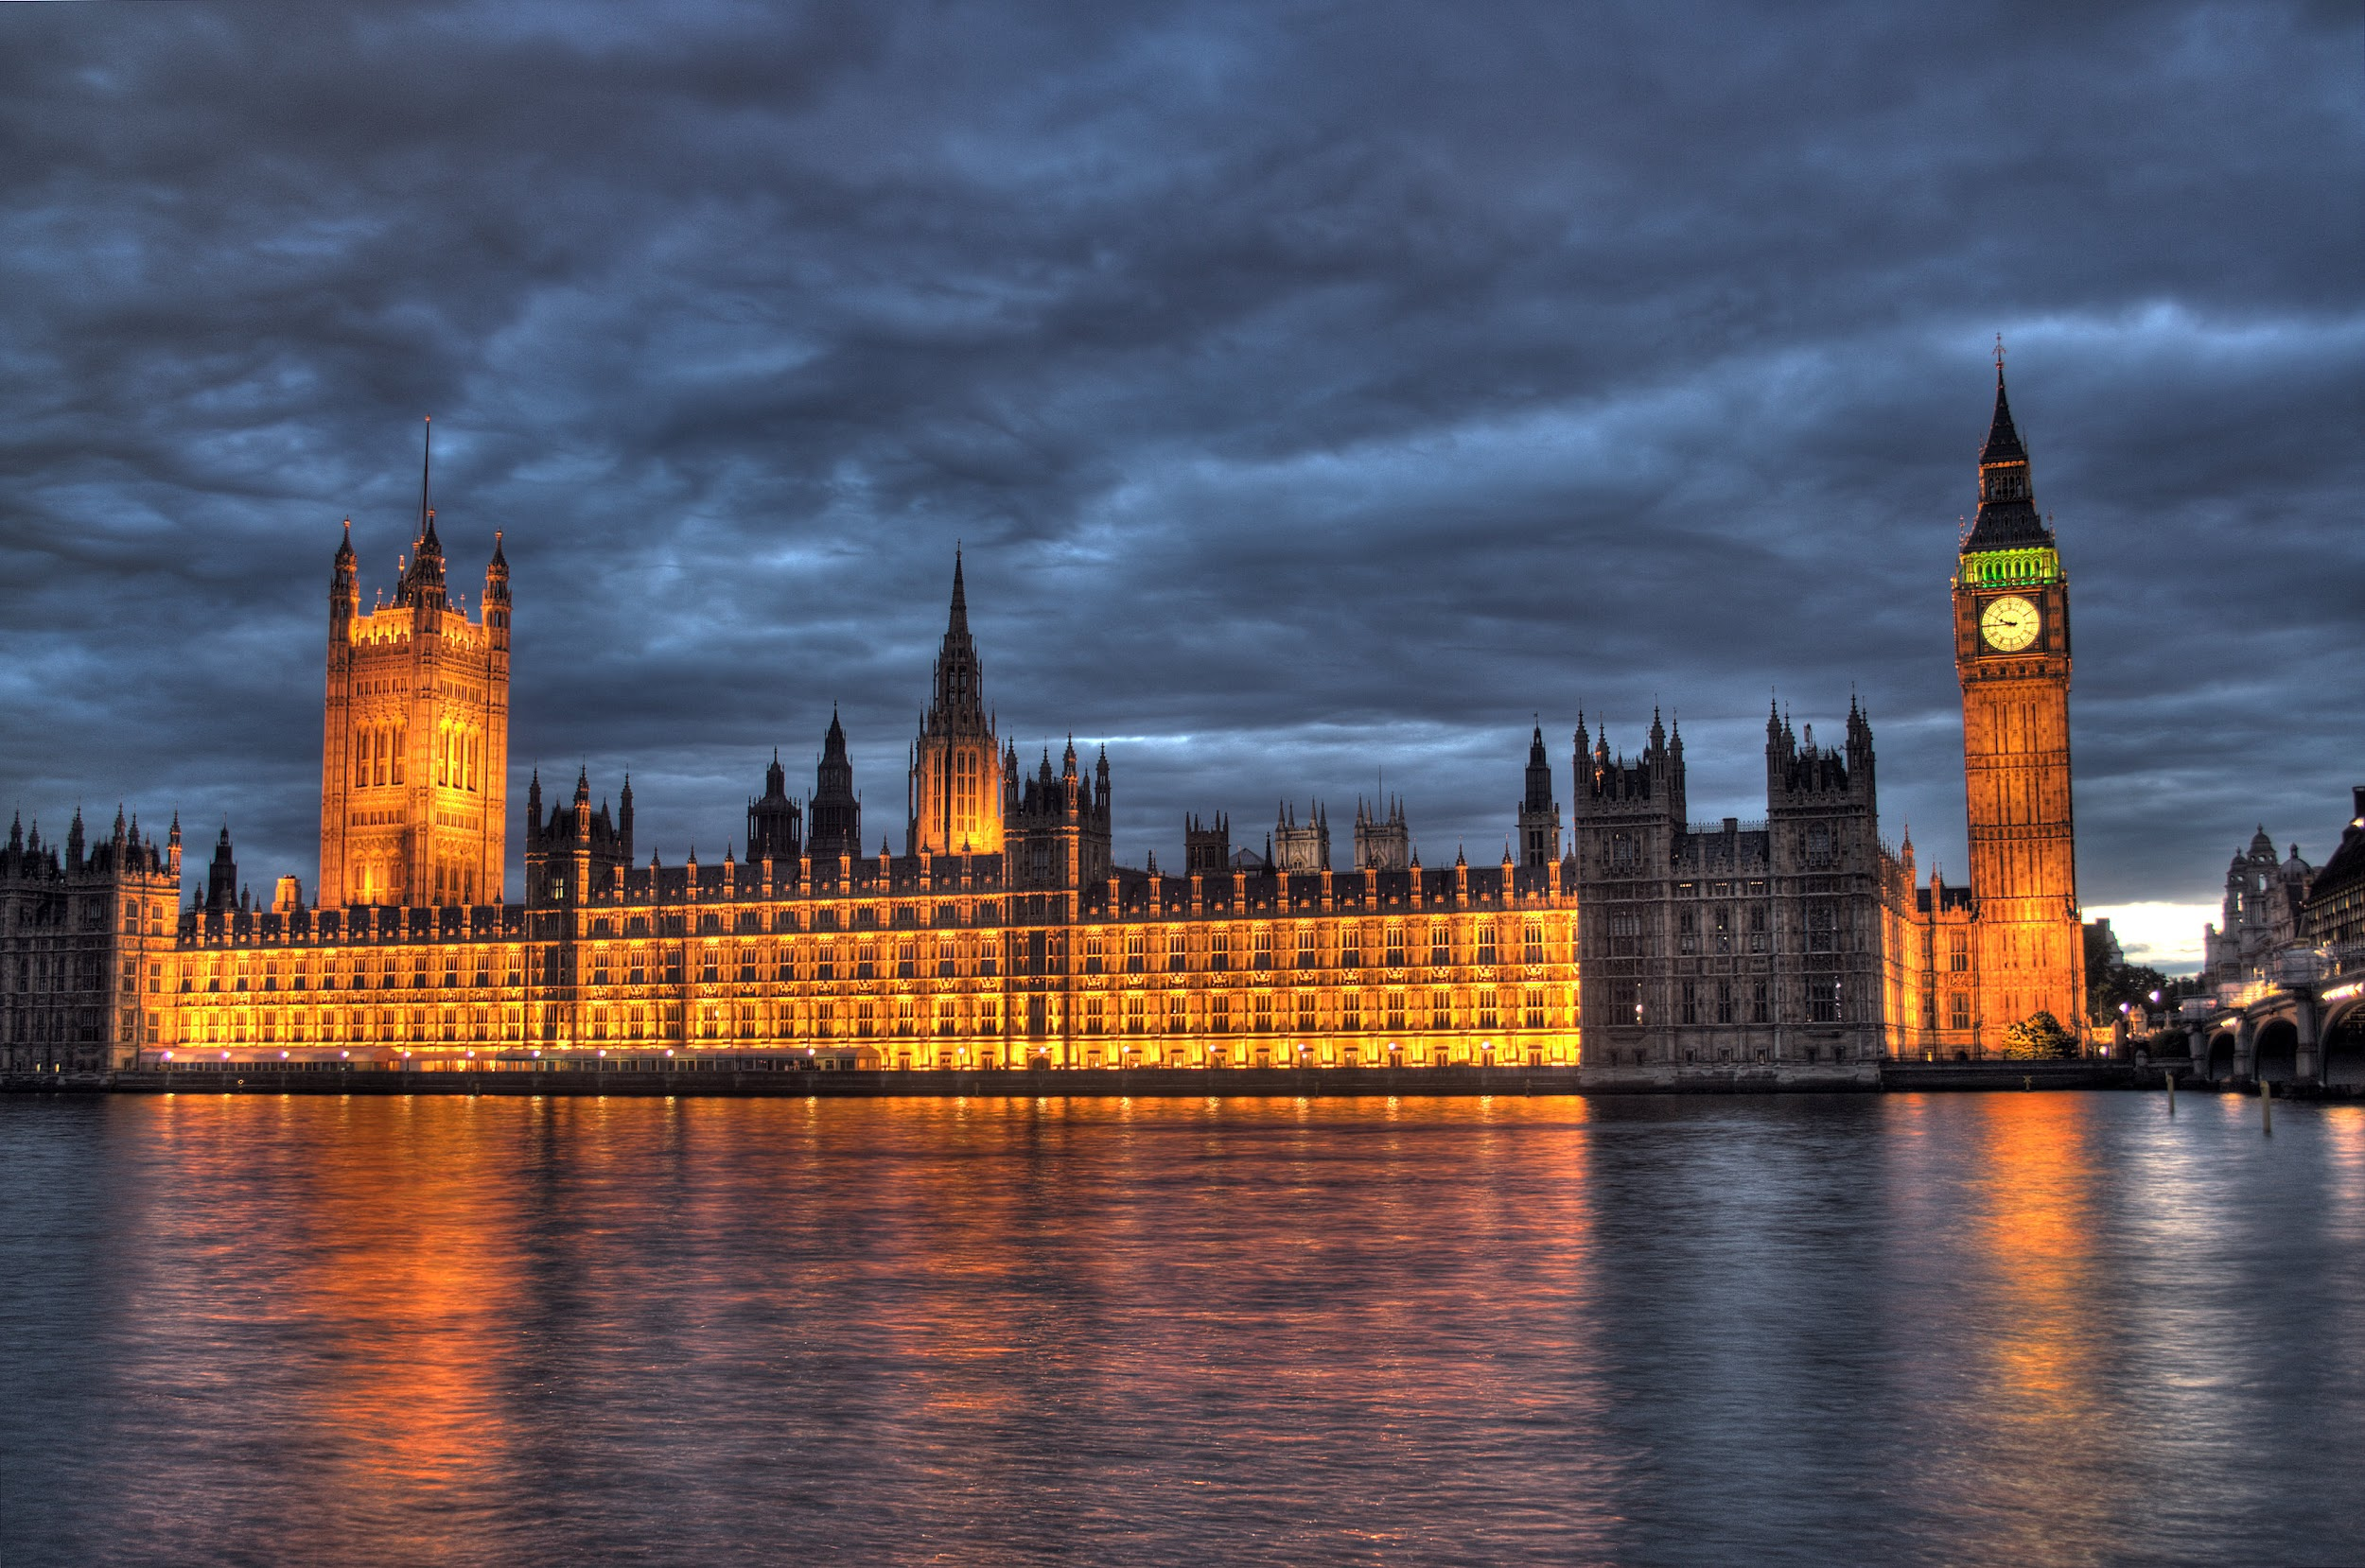
Houses of Parliament
The Houses of Parliament do not have a dress code but you definitely are not allowed to wear a suit of armour. The law is set out in the Statute forbidding Bearing of Armour or coming Armed to Parliament Act 1313 and was enacted to deal with the then noblemen’s pesky habit of using armed force in order to cause trouble - and we thought today’s parliament could get fiery. The whole drama goes under the name of The Great Stink of 1858. The river smelt so bad the Parliament first tried to dip their curtains in a mix of lime and chloride to hide the smell… to no avail. It got so bad that they laid down a bill and made it into law a speedy 18 days - the law paved the way for the extensive plumbing infrastructure and hygiene laws that saved London from its smelly past.

