Slide 1
Landmarks of London
By Harry Q and Tyler W

Slide 2
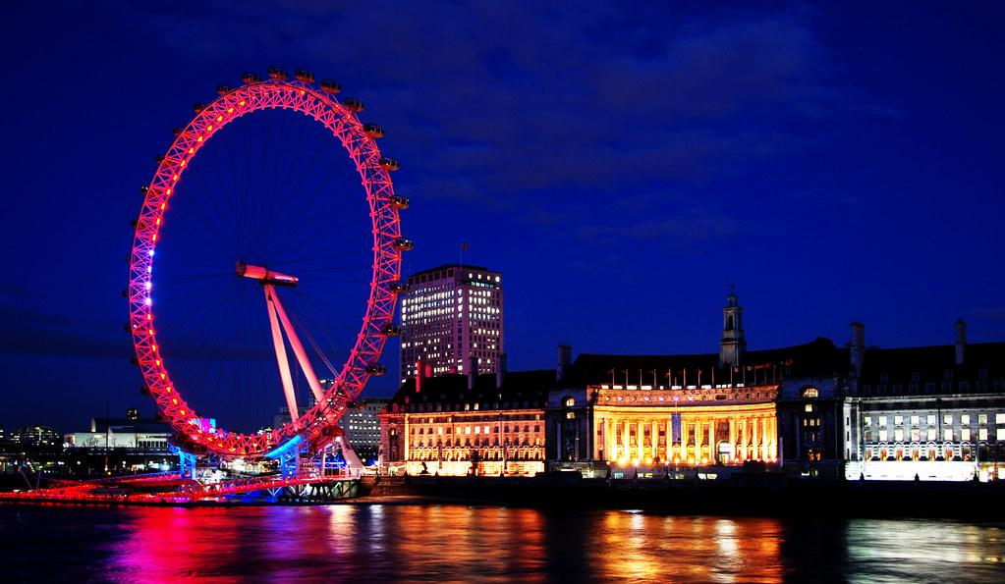
London eye
The london eye is a huge ferris wheel that towers over london and it takes over 30 minutes to do full 360 turn. At night it lights up the street of london and it can easily be seen across london.

Slide 3
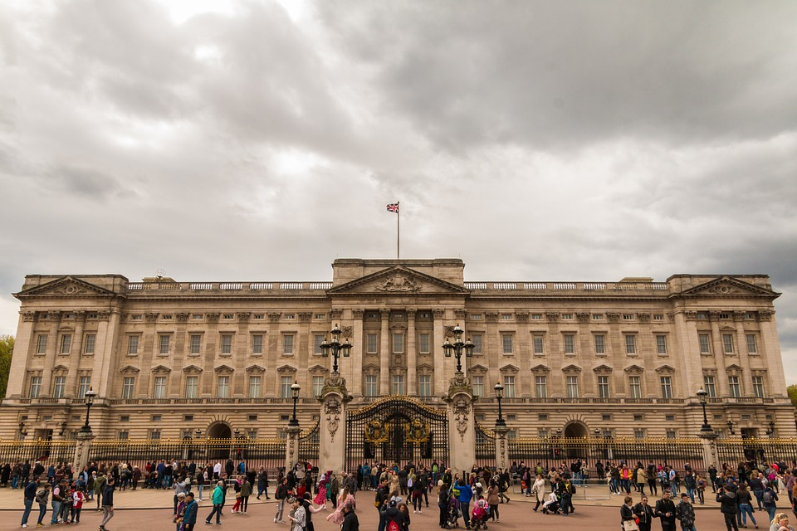
Buckingham palace
The buckingham palace is a place where the King or Queen lives. It has been built years and years ago.Though the Palace is generally not open to the public, during summer you can visit its State Apartments (admission charge) and see the Queen's large garden and collection of artwork. You can however see the Changing of the Guard for free at 11.30 am every morning during summer and every second morning during winter.

Slide 4
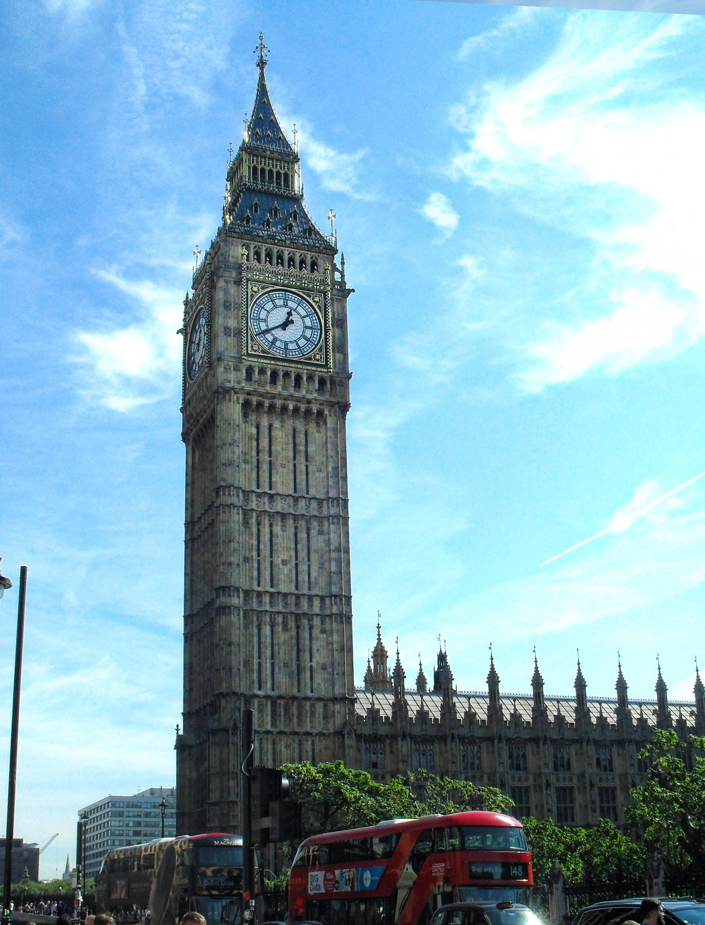
Big ben
Big Ben is located on the north bank of the river Thames, in the borough of Westminster in London. The borough of Westminster is also home to Buckingham Palace (only a 15-minute walk from the clock tower) and Westminster Abbey (a four-minute walk from the clock tower). Westminster is one of 32 boroughs that make up London. More specifically, Big Ben is on the northern end of the Palace of Westminster, AKA The Houses of Parliament.its real name is st stephens tower.

Slide 5
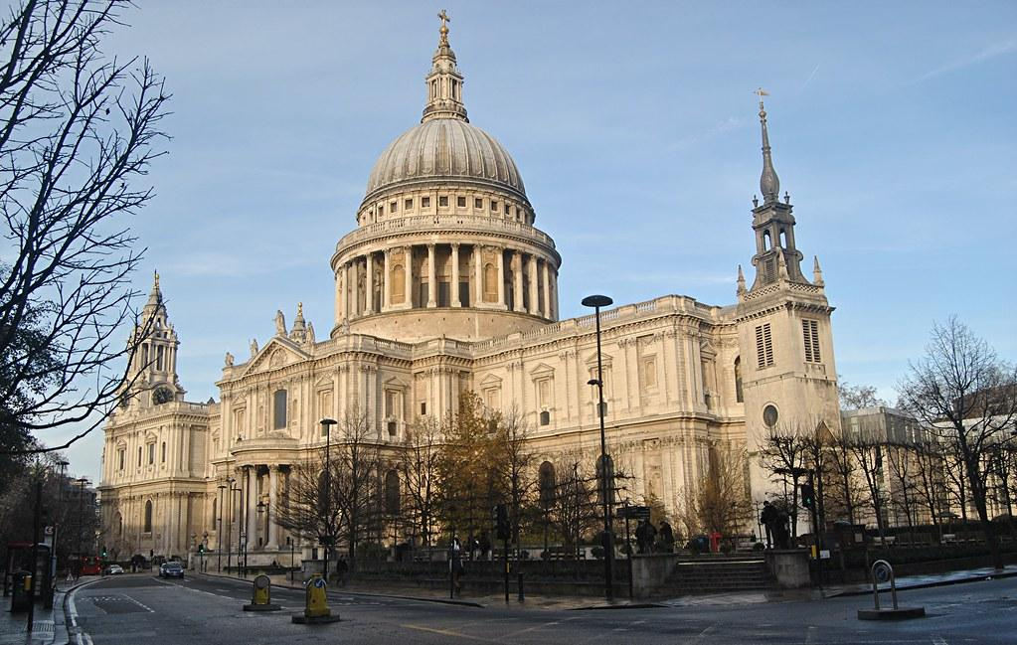
St. Paul’s Cathedral
St. Paul’s Cathedral is a church that was around for years and years. It had got destroyed multiple times in war. It was from a funeral in lord Nelson, winston churchill, prince charles and Diana Spencer. It was built between 1675 and 1710.

Slide 6
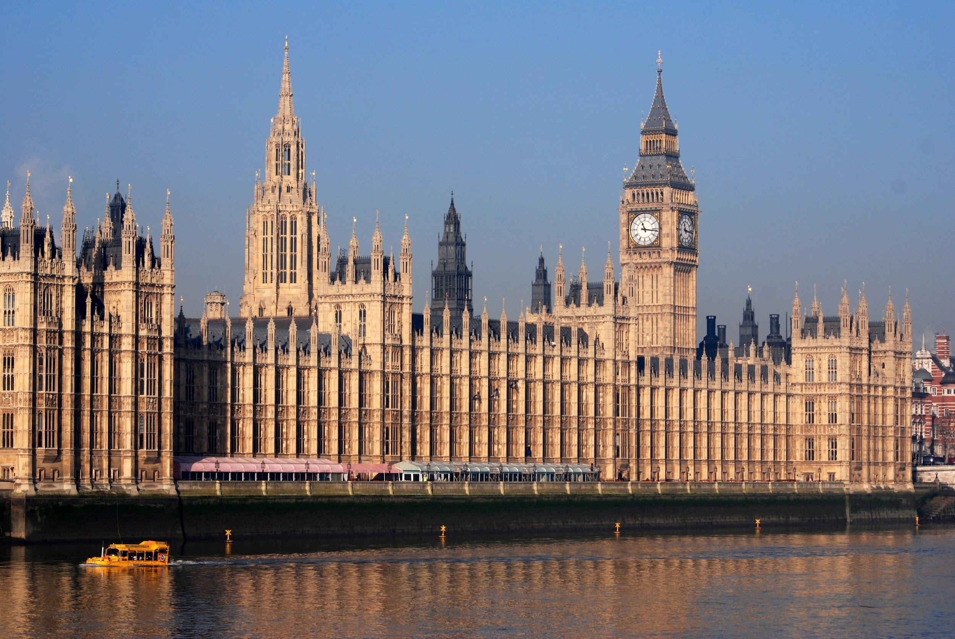
Houses of parliament
Parliament is the legislature, or lawmaking group, in the government of the United Kingdom (Great Britain). The government leader, called the prime minister, is always a member of Parliament. This makes Britain different from the United States, which keeps Congress and the president in separate branches of government.

Slide 7
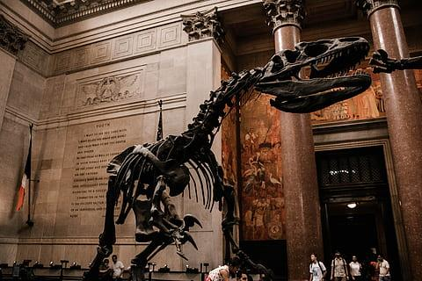
Natural history museum
The Natural History Museum (NHM) is a museum in London. It is the largest natural history museum in Britain. It includes the nation's main collections of specimens of life, rocks and minerals. The museum employs scientific staff, conducts research, stores specimens, and manages the public galleries.

