Slide 1

Welcome to Year 4!

Slide 2
Teachers
Mr Graham (Class 9) and Miss Burns (Class 10)
Supported by Mrs Durkin
Our Timings: 8.40am – 3.10pm

Slide 3
What will my child be learning?
In Autumn term, our topic is Ancient Greece. We will be learning about early democracy, beliefs, art, theatre, war and much more in this era. This topic involves a fantastic trip to Leeds City Museum which will be on the 17th October - we also have expert visitors in school. We had our first visitor on Monday so look out for photos of what we did on the class pages of our website.
Home learning mats can be found in the home learning diary and are added to the class page on the school website each half term, linking to the new topic.

Slide 4
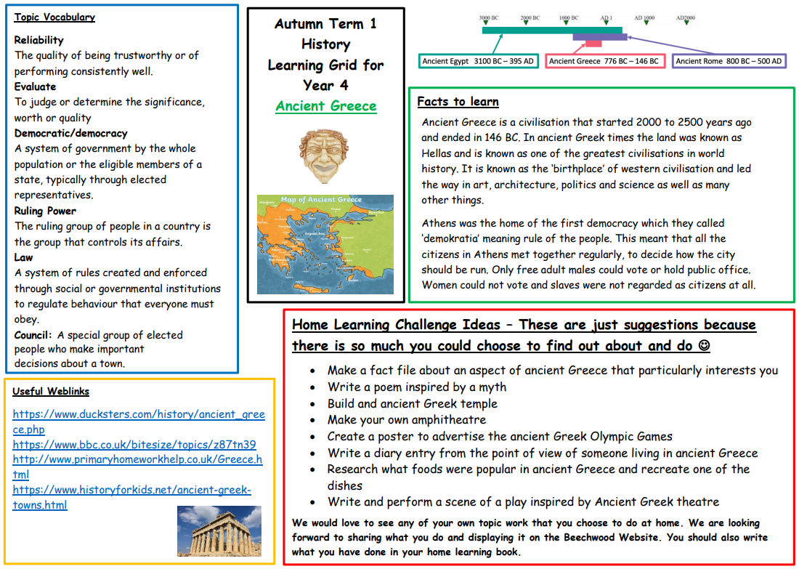
Year 4 home learning grid

Slide 5
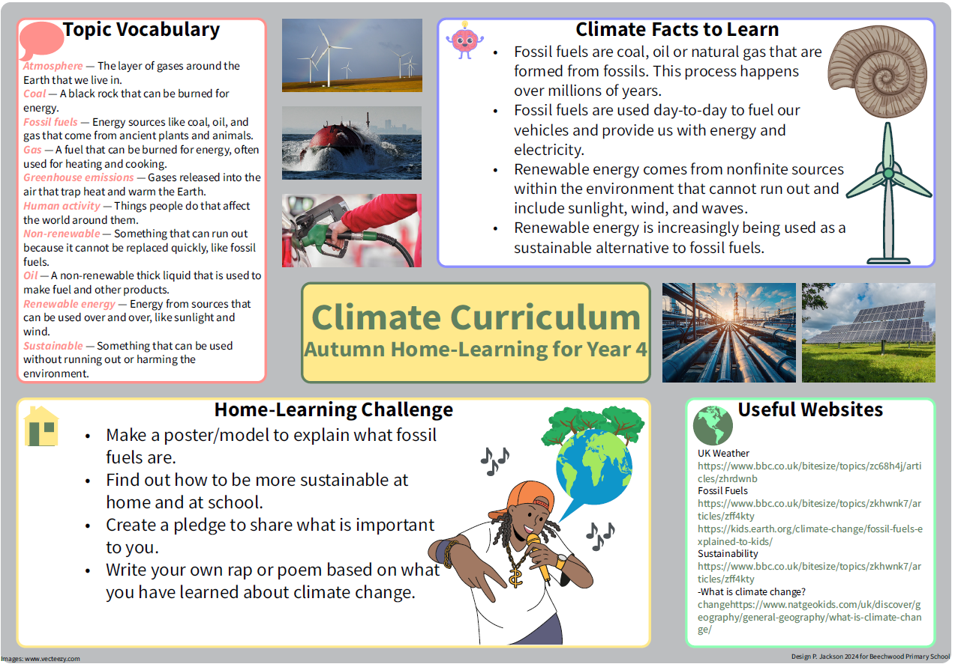
Year 4 Climate Learning Mat
In November, there will be a whole school climate joy day.
Year 4 will be taking part in a climate related programme called ‘Green Schools'.

Slide 6


We also have Golden Opportunities which they will tick off as the year progresses. These can also be found in the home learning diaries alongside our Beechwood Golden Opportunities which children will tick off by the end of their time at Beechwood.
Year 4 Golden Opportunities
Beechwood Golden Opportunities

Slide 7
How can I support my child at home?
Spellings are given out every Monday and children should practise these at home as well as at school. They should bring completed spellings back on Friday for our spelling test.
Maths homework will be set weekly on Mondays and is due back the following Monday.
Please record homework and home reading in the home learning diaries and make sure your child brings these to school each day.
Please continue to practise times tables with your child- up to 12 x 12, both multiplication and division facts.

Slide 8
Statutory testing
The Multiplication Tables Check (MTC) is a key stage 2 assessment taken by Year 4 pupils at the end of year 4 (in June). The MTC’s purpose is to check whether their times tables knowledge is at the expected level. This is done in all primary schools in England.
The Multiplication Times Tables Check is an online test where children are asked 25 questions on times tables 2 to 12.
For every question, children have 6 seconds to answer, and in between the questions, there is a 3-second rest.
A good way to prepare is to start early and build a daily routine practising the times tables.
This will be a big focus of homework and arithmetic lessons in school and you can help your child by practicing regularly at home too.
Hit the Button, Sound Check on TTRS and www.timestables.co.uk

Slide 9

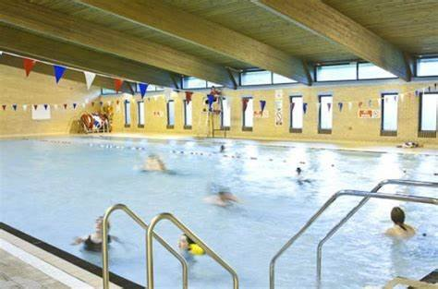
Swimming – Spring Term
Swimming will take place at Fearnville Leisure Centre and this is part of the KS2 P.E. National Curriculum. Each class will swim for a 30-minute session each Wednesday morning except for the first and last week of each full term. The lessons are taught by trained swimming teachers from the pool and Beechwood staff. The children are split into smaller groups for the lessons.
Pupils need to bring a towel to school each week in a bag that they can put their clothes in. They do not need any money.
Please send children to school wearing their swimming costumes under their normal clothes as this makes changing at the pool more efficient.

Slide 10

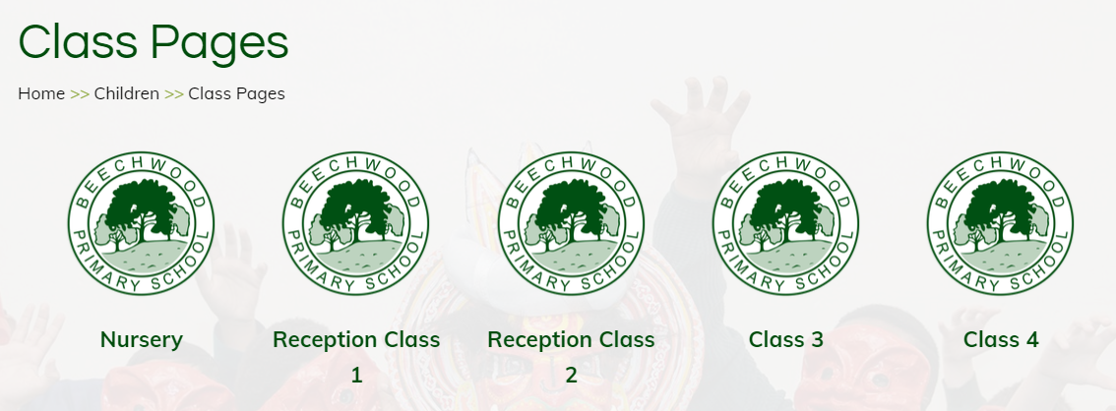
Where can I find out about events in school?
Important dates will be sent out via the school newsletter.
Class pages are updated regularly on the school website showing photos and updates of what your children have been learning about in school. We also have an Awards page to celebrate certificate winners each week.
Texts are sent home via my school app so please make sure you are signed up to this.

Slide 11
R.E. at Beechwood
At Beechwood, we follow the Believing and Belonging RE syllabus, which was updated last year. Our approach promotes inclusivity, respect and tolerance, ensuring all pupils gain a broad understanding of diverse beliefs and practices. Educational visits play a key role in bringing learning to life, offering real-world experiences that deepen pupils' understanding of different faiths. We also celebrate Interfaith Week with a rich programme of visitors, workshops and assemblies taking place during the year; fostering a respectful and open-minded school community.

Slide 12
What can my child bring to school?
Children are asked to bring a water bottle into school each day.
Children should bring their home learning diary to school each day- please record any home learning and reading completed at home in these. Teachers will check these weekly.
Please make sure your child wears PE kit on Tuesday and (Wednesday Class 10 - Thursday Class 9).

Slide 13
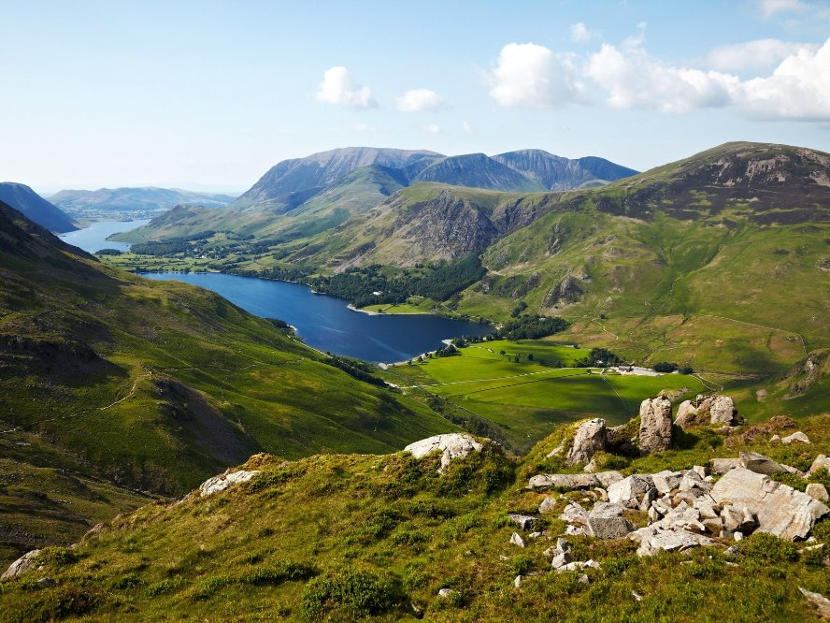
The Year 4 Lake District Residential
This is a fantastic one night residential in May that connects to our summer term topic.
We leave school at 8.30am on day one and arrive back to school at about 5.30pm on day two. We stay in Hawkshead Youth Hostel and spend our time exploring the area around the youth hostel and doing activities in the town of Keswick.
The children sleep in dormitories with their friends and all food is provided by the Youth Hostel Staff.
More information will follow about this trip soon. Please see Mr Graham if you have any questions.

Slide 14
Who can I speak to?
Your child’s teacher and teaching assistant will be available to speak to quickly on the playground in the morning and afternoon.
For any bigger queries or conversations, please speak to, phone, or email our office team and they can arrange a meeting or a phone call with your child’s class teacher.

Slide 15
Attendance
In order for your child to enjoy all that is on offer at Beechwood and to ensure that they make the excellent progress that we know they can, it is important that they are in school each day on time. We have many exciting attendance rewards.
Just a few from last year were:
Cinema vouchers Scooter
Slime Bikes
Bubble football

Slide 16
Thank you for coming and helping us to support your child in Year 4 ☺

