Slide 1

Welcome to Year 4!

Slide 2
Teachers
Mrs Sturman and Mrs Powley (Class 9)
Miss Callaby (Class 10)
HLTA Mrs Baldwin
Supported by Mrs Hunter
Our Timings: 8.40am – 3.10pm

Slide 3
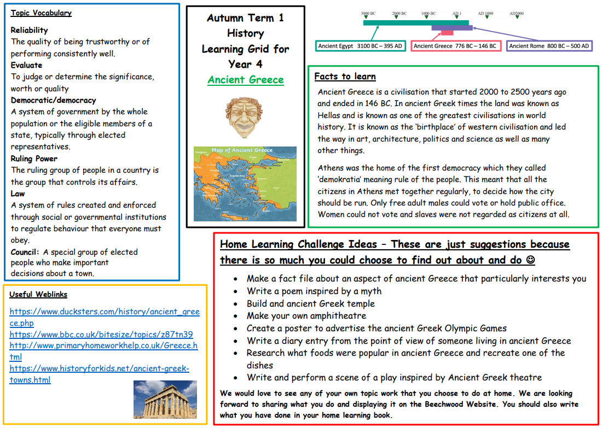
This term
This term we will be learning all about Ancient Greece and what daily life was like for the Ancient Greeks. As part of this topic, we have planned a visit to Leeds City Museum on Tuesday 20th October and we have booked two Ancient Greek workshops that will happen in school. These will take place on Tuesday 22nd September and Tuesday 3rd November.
Home learning grids for our topics are in the home learning diary and they are added to the class pages on the school website. Please make sure your child brings any home learning in to show us so we can celebrate it in class.

Slide 4
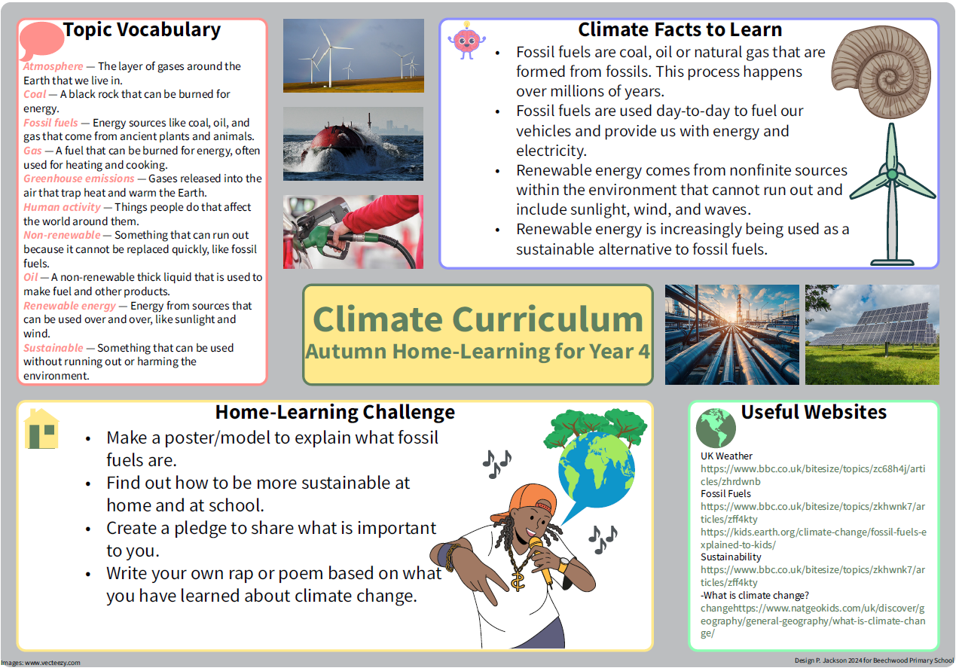
Year 4 Climate Learning Mat
In November, there will be a whole school climate joy day.
Year 4 will be taking part in a climate related programme called ‘Green Schools'.

Slide 5


Each year group has Golden Opportunities which we tick off as the year progresses. These can also be found in the home learning diaries.

Slide 6

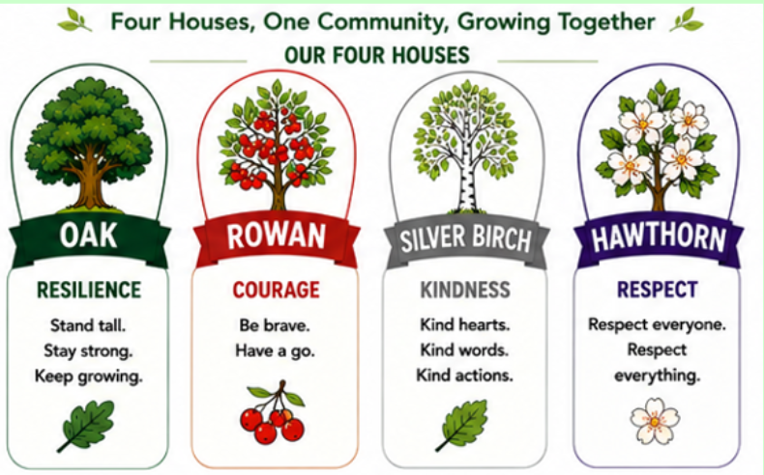
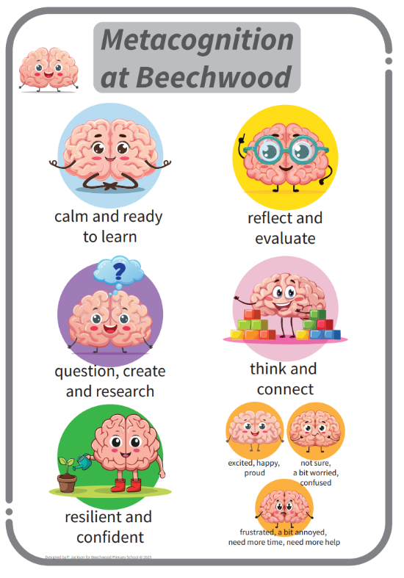
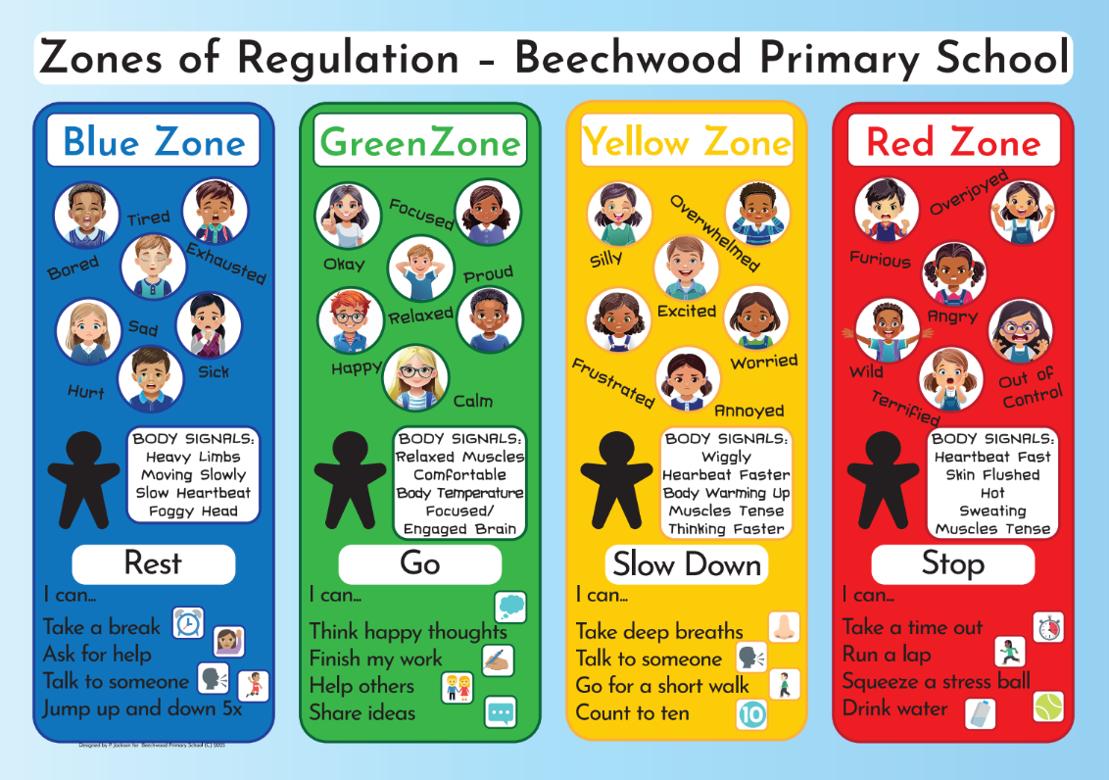
New at Beechwood

Slide 7
Supporting your child at home
Spellings are given out every Monday for children to practise at home as well as at school. They should bring completed spellings back on Friday for our spelling test.
Maths homework will be set weekly on Mondays and is due back the following Monday.
Please record homework and home reading in the home learning diaries and make sure your child brings these to school each day.
Please continue to practise times tables with your child- up to 12 x 12, both multiplication and division facts.

Slide 8
Statutory testing
The Multiplication Tables Check (MTC) is a key stage 2 assessment taken by Year 4 pupils at the end of year 4 (in June). The MTC’s purpose is to check whether their times tables knowledge is at the expected level. This is done in all primary schools in England.
The Multiplication Times Tables Check is an online test where children are asked 25 questions on times tables 2 to 12.
For every question, children have 6 seconds to answer, and in between the questions, there is a 3-second rest.
A good way to prepare is to help your child learn and practise a few facts a week.
This will be a big focus of homework and arithmetic lessons in school and you can help your child by practicing regularly at home too.
Hit the Button, Sound Check on TTRS and www.timestables.co.uk

Slide 9

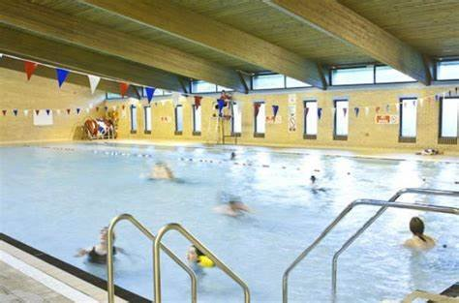
Other opportunities
Swimming – Spring Term
Swimming will take place at Fearnville Leisure Centre and this is part of the KS2 P.E. National Curriculum. Each class will swim for a 30-minute session each Wednesday morning. The lessons are taught by trained swimming teachers from the pool and Beechwood staff.
More information will follow later this term.
Steel Pans
Your children can choose to join steel pan lessons this year. These are
taught by a musician who comes to school
every Friday afternoon.

Slide 10
School Events
Important dates will be sent out via the school newsletter.
Class pages are updated regularly on the school website showing photos, class awards and updates of what your children have been learning about in school.
Texts are sent home via my school app so please make sure you are signed up to this.
Attendance
In order for your child to enjoy all that is on offer at Beechwood and to ensure that they make the excellent progress that we know they can, it is important that they are in school each day on time. We will have many exciting attendance rewards again this year.

Slide 11
R.E. at Beechwood
At Beechwood, we follow the Believing and Belonging RE syllabus, which was updated last year. Our approach promotes inclusivity, respect and tolerance, ensuring all pupils gain a broad understanding of diverse beliefs and practices. Educational visits play a key role in bringing learning to life, offering real-world experiences that deepen pupils' understanding of different faiths. We also celebrate Interfaith Week with a rich programme of visitors, workshops and assemblies taking place during the year; fostering a respectful and open-minded school community.

Slide 12
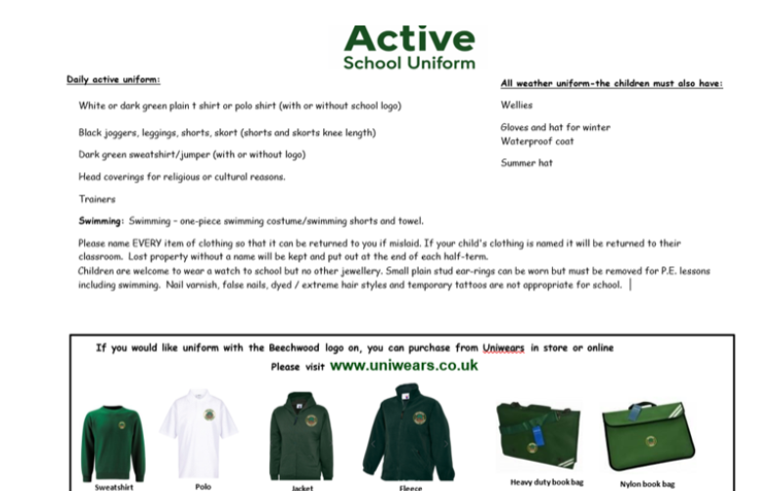
We have joined an exciting playground scheme called OPAL and this year we will be focusing on how to improve what we offer the children at playtime and lunchtime at Beechwood.

Slide 13
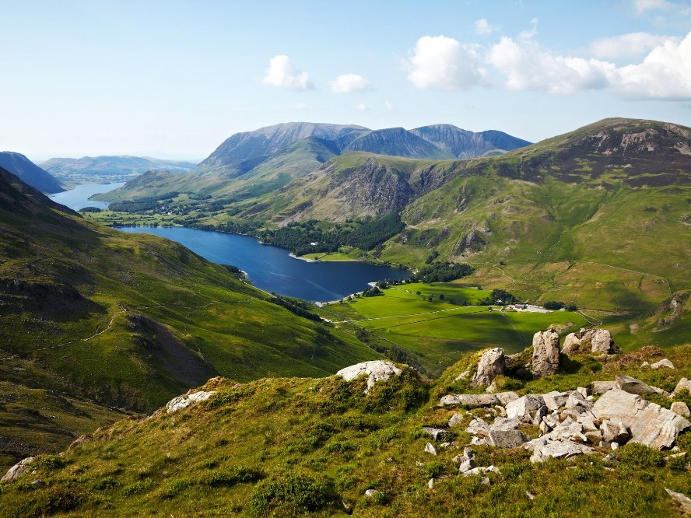
The Year 4 Lake District Residential
This is a fantastic one night residential in May that connects to our summer term topic.
We leave school at 8.30am on day one and arrive back to school at about 5.30pm on day two. We stay in Hawkshead Youth Hostel and spend our time exploring the area around the youth hostel and doing activities in the town of Keswick.
The children sleep in dormitories with their friends and all food is provided by the Youth Hostel Staff.
More information will follow about this trip soon. Please see Miss Callaby if you have any questions.

Slide 14
Thank you for coming and helping us to support your child in Year 4 ☺
Please feel free to speak to us anytime you have any questions or concerns.

