Slide 1

Welcome to Year 3!

Slide 2
Teachers
Miss Karagic and Mrs Isenring (Class 7) and Mrs Ilsley (Class 8)
Supported by Mrs Meston and Miss Khan
Our Timings: 8.45am – 3.15pm

Slide 3
What will my child be learning?
In Autumn term, our topic is history based. We will be learning about different invaders and settlers, starting with the Stone age, moving onto the Romans and finishing with Anglo Saxons/Vikings before Christmas. Our science topics this term are focused on healthy lifestyles and rocks/soils which involves a fantastic trip to Meanwood Valley farm in December – more information to follow. Home learning mats can be found in the home learning diary and are added to the class page on the school website each half term, linking to the new topic.

Slide 4
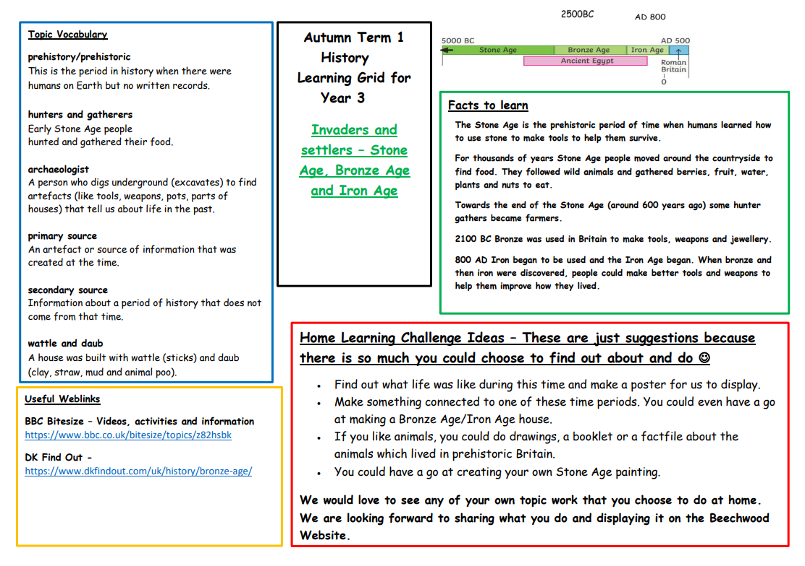
Year 3 home learning grid

Slide 5
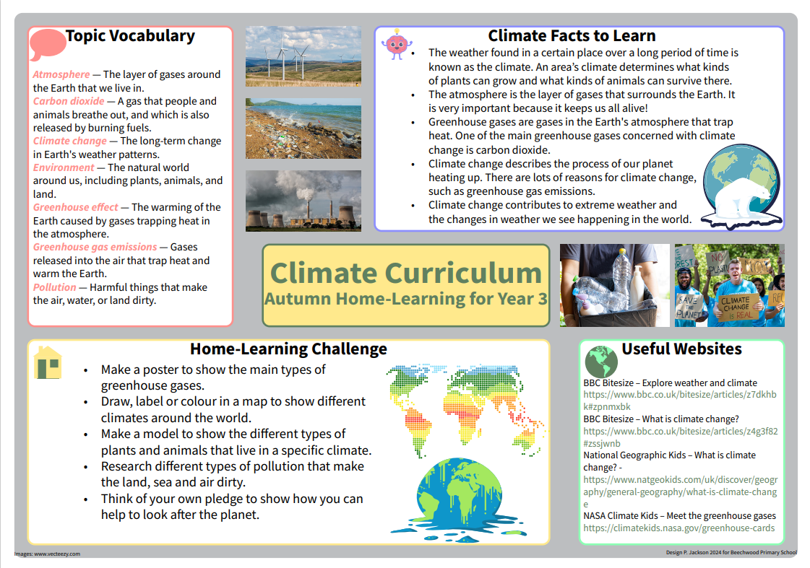
Year 3 Climate Learning Mat

Slide 6


We also have Golden Opportunities which they will tick off as the year progresses. These can also be found in the home learning diaries alongside our Beechwood Golden Opportunities which children will tick off by the end of their time at Beechwood.
Year 3 Golden Opportunities
Beechwood Golden Opportunities

Slide 7
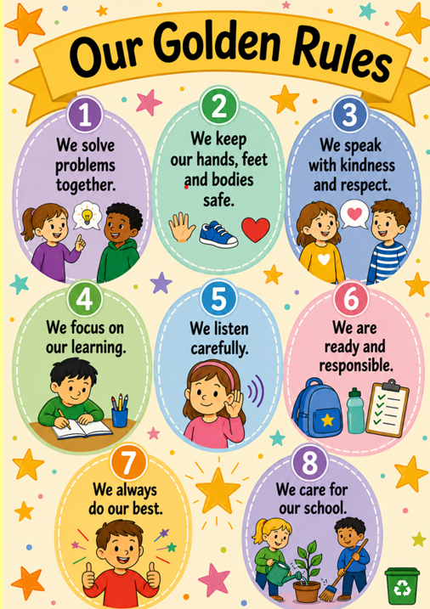
Golden Rules
We have introduced some new Golden Rules this year and children are rewarded with house point and Golden time for following the rules and consequences will be given for not following the rules.

Slide 8
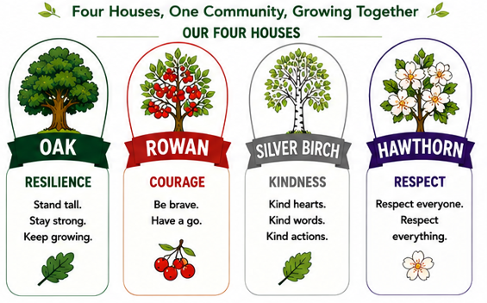
Houses
Every child and adult at our school will be a part of a Beechwood House (like a team). Siblings will be in the same house.
Adults in school will give house points to children who are following our Golden Rules.
These house points will be added up at the end of each week and the overall winning House will win a trophy in our Friday assembly.
We will learn house songs and take part in house competitions.

Slide 9
How can I support my child at home?
Spellings are given out every Monday and children should practise these at home as well as at school. They should bring completed spellings back by the following Friday for our spelling test.
Maths homework will be set weekly starting soon. Please record homework and home reading in the home learning diaries and make sure your child brings these to school each day.
Please continue to practise times tables with your child, both multiplication and division facts.
Here are some useful websites you could you to help your child at home.
Hit the Button and TTRS and www.timestables.co.uk
Ed Shed for spellings www.edshed.com
Purple Mash www.purplemash.com

Slide 10
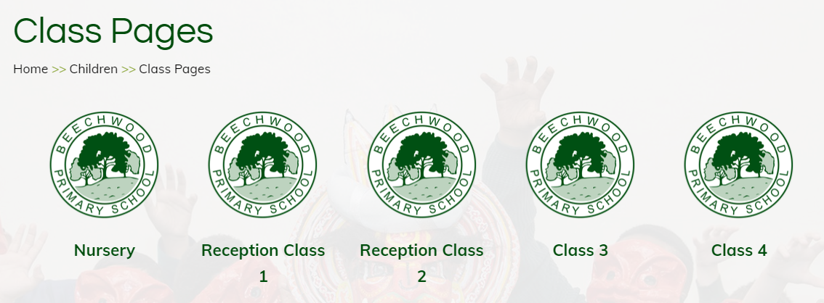
Where can I find out about events in school?
Important dates will be sent out via the school newsletter.
Class pages are updated regularly on the school website showing photos and updates of what your children have been learning about in school. We also have an Awards page to celebrate certificate winners each week. Please make sure you have updated permissions for photographs on Arbor.
Texts are sent home via my school app so please make sure you are signed up to this.

Slide 11
R.E. at Beechwood
At Beechwood, we follow the Believing and Belonging RE syllabus, which was updated last year. Our approach promotes inclusivity, respect and tolerance, ensuring all pupils gain a broad understanding of diverse beliefs and practices. Educational visits play a key role in bringing learning to life, offering real-world experiences that deepen pupils' understanding of different faiths. We also celebrate Interfaith Week with a rich programme of visitors, workshops and assemblies taking place during the year; fostering a respectful and open-minded school community.

Slide 12
What can my child bring to school?
Children are asked to bring a water bottle into school each day.
Children should bring their home learning diary and their reading book to school each day- please record any home learning and reading completed at home in these. Teachers will check these weekly.
Please make sure your child wears PE kit on Tues and Thurs (Class 7) and Mon and Tues (Class 8)

Slide 13
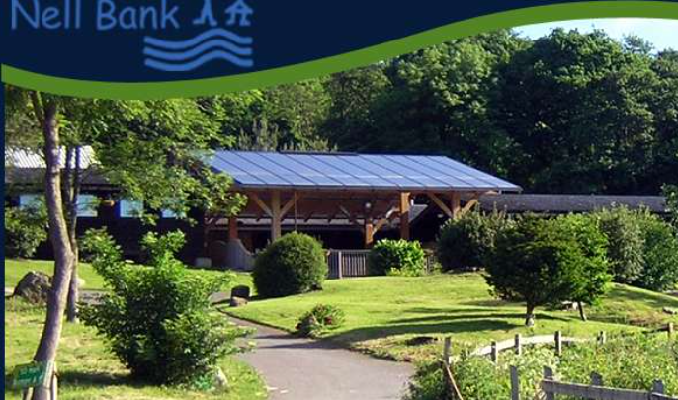
The Year 3 Nell Bank Residential
This is a fantastic one night residential on March 30th in Ilkley..
We stay at Nell Bank Centre and spend our time exploring the grounds and carrying out activities such as den building, pond dipping and orienteering. All activities are led by trained staff from the centre, aswell as Beechwood adults.
The children sleep in dormitories with their friends.
More information will follow about this trip soon. If you have any questions please see us at anytime. Our Beechwood office team will be able to give you more information about the payment plan for this trip.
www.nellbank.org .

Slide 14
Who can I speak to?
Your child’s teacher and teaching assistant will be available to speak to quickly on the playground in the morning and afternoon.
For any bigger queries or conversations, please speak to, phone, or email our office team and they can arrange a meeting or a phone call with your child’s class teacher.

Slide 15
Attendance
In order for your child to enjoy all that is on offer at Beechwood and to ensure that they make the excellent progress that we know they can, it is important that they are in school each day on time. We have many exciting attendance rewards.
Just a few from last year were:
Cinema vouchers Scooter
Slime Bikes
Bubble football

Slide 16
Thank you for coming and helping us to support your child in Year 3 ☺

